Slide 1
COnVERSA. Un’introduzione al test di comprensione delle opposizioni morfosintattiche verbali attraverso la scrittura.
Cristiano Chesi
NETS, IUSS LAB for Neurolinguistics, computational linguistics and theoretical Syntax
In collaborazione con Giorgia Ghersi (UnIPI), Valentina Musella e Debora Musola (Cooperativa logogenia)
Prospettive interdisciplinari nella misura di competenze e abilità linguistiche in età scolare Padova – 25 Giugno 2024

Slide 2
Outline
Deaf children oral competence assessment
Grammaticality judgments rather than comprehension task
Controlled lexical items and minimal pairs
Phenomena to be tested and their complexity
Cartography, locality and the “growing tree” idea (Friedmann, Belletti & Rizzi 2021)
Measuring complexity combining “functional height” and “locality”
Validation results
The task is reliable and corroborates major findings discussed in the language acquisition literature
Age and Complexity are major predictors of hearing children’s performance on COnVERSA
Deaf people performance on this test significantly differs from hearing children in a relevant way
ChatGPT… is different!

Slide 3
Deaf children oral competence assessment
Frustrating experience: lip reading induces a degradation in the linguistic input quality (poor understanding of the task)
Reading is slower and can be used only after training
Comprehension task: e.g. picture or character matching task cannot be used extensively to assess multiple linguistic domains in an effective way (too long, not an easy task for deaf children who need lip reading, joint attention loss…)
Standard tests: TROG-2 (Bishop 2009) / WISC IV (Wechsler 2003) are not suitable for deaf (oral tasks); they target non-specific linguistic aspects and require a psychologist to be administered; COMPRENDO (Cecchetto et al. 2012) is too complex for children though it presents the kind of linguistic granularity we would be interested in. (see Cardinaletti 2019)

Slide 4
A proposal: COnVERSA Test di Comprensione delle Opposizioni morfo-sintattiche VERbali attraverso la ScritturA
Based on Grammaticality Judgments (Version 3): simple sentences to be judged
Lexical items are controlled: only elementary words are included (cf. Lessico Elementare, Marconi et al. 1994)
Rich set of phenomena tested: functional fields are selectively tested (DP, IP, CP)
Two administration procedures tested (version 3): complete and dynamic
Complete mode (240 items); divided in two parts (A and B) that can be administered at the beginning and at the end of a specific (logopedic) training; each part is divided in two sections (about 10-15 minutes each).
The Dynamic mode uses a complexity metric to select the block to be prompted; the following block is chosen according to child’s performance: if the child succeeds in 80% of the items of the previous block an increasing complexity block is proposed, if the child performance on the previous block is below 80%, a less complex block is selected.
Version 3

Slide 5
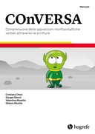
A proposal: COnVERSA Test di Comprensione delle Opposizioni morfo-sintattiche VERbali attraverso la ScritturA
Based on Forced Choice (Version 4): still simple sentences to be judged… but comparatively
Lexical items are still controlled: "Fundamental Words" vs. "Highly-used" vs. "Highly-availabile" (cf. Nuovo Vocabolario di Base, De Mauro 2016)
Same set of phenomena tested
Four ways to test a dependency:
A - Agreement
B - Thematic structure
C - Pronominalization
D - Wh- questions
Three control checks: Vocabulary richness, featural sensitivity and Working Memory / Attention
The complete administration modality split:
Base (144 items) + Advanced (200 items); each divided in two equivalent (but lexically different) parts (A and B); each part is divided in two sections (about 7-14 minutes each)
Version 4

Slide 6
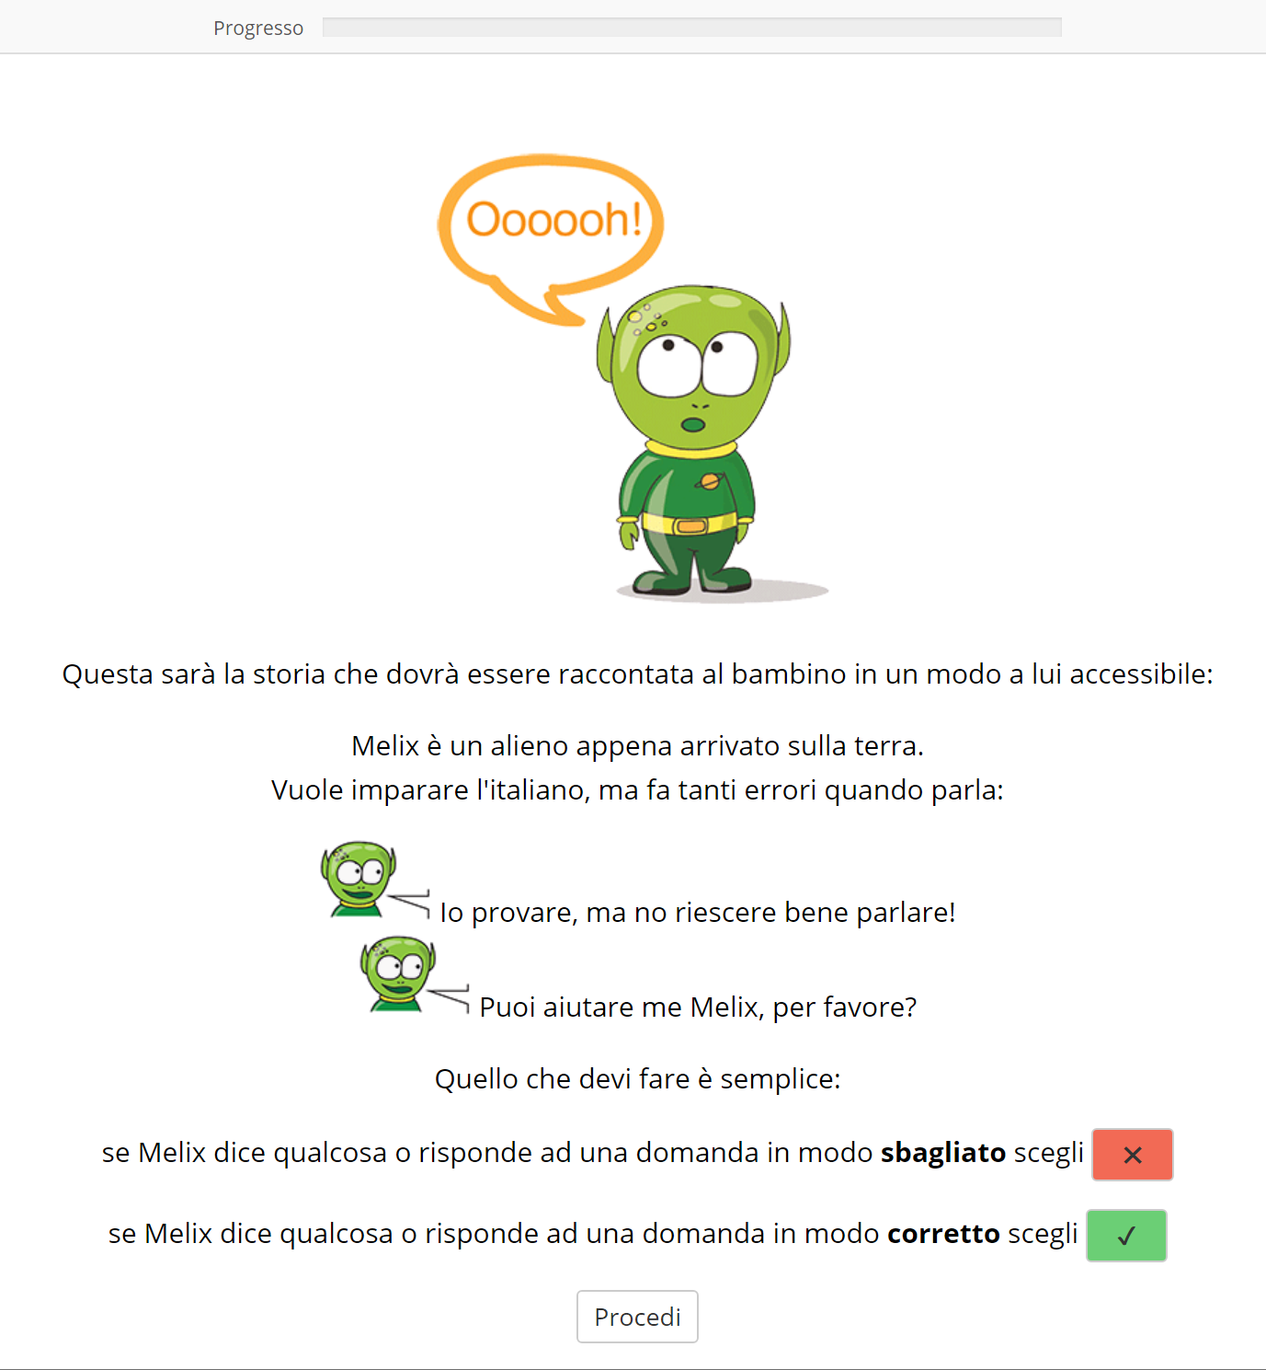
A proposal: COnVERSA Test di Comprensione delle Opposizioni morfo-sintattiche VERbali attraverso la ScritturA
A simple story to set-up the task:
The instructor tells the child a story about an alien (Melix) who came to the Earth and want to learn Italian.
(S)he tries producing sentences and answer questions, but sometimes (s)he generates wrong expressions.
The child should help her/him by indicating if her/his production was ok or not.
Version 3

Slide 7
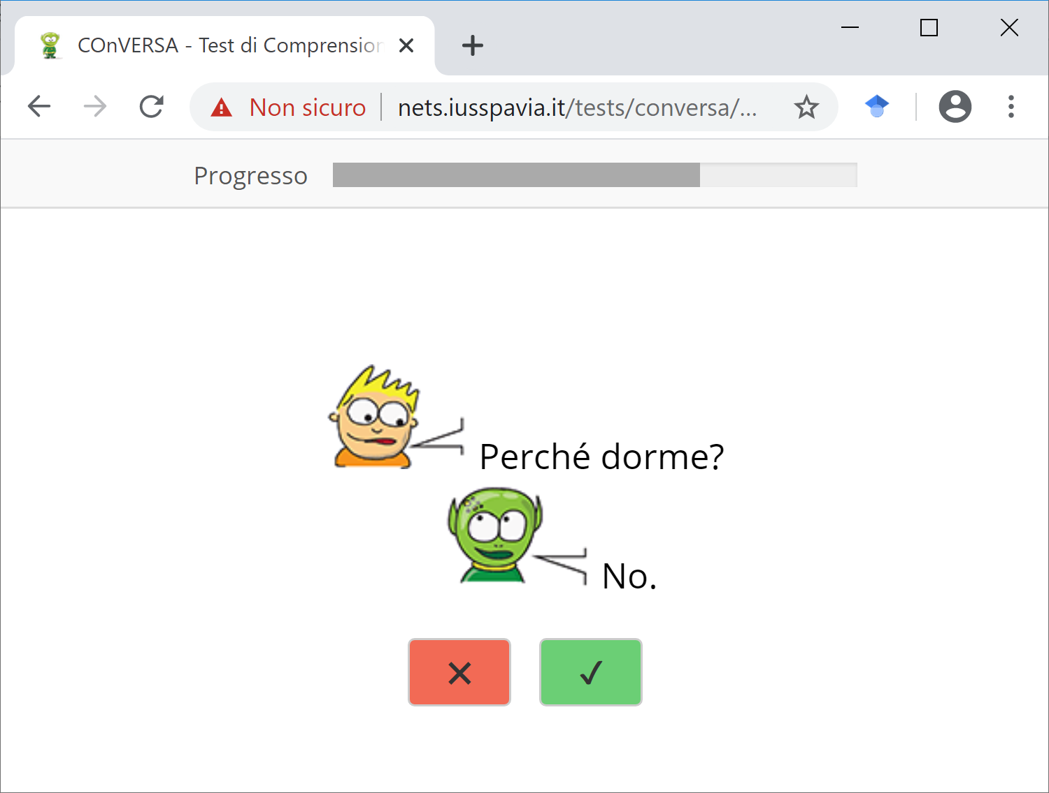
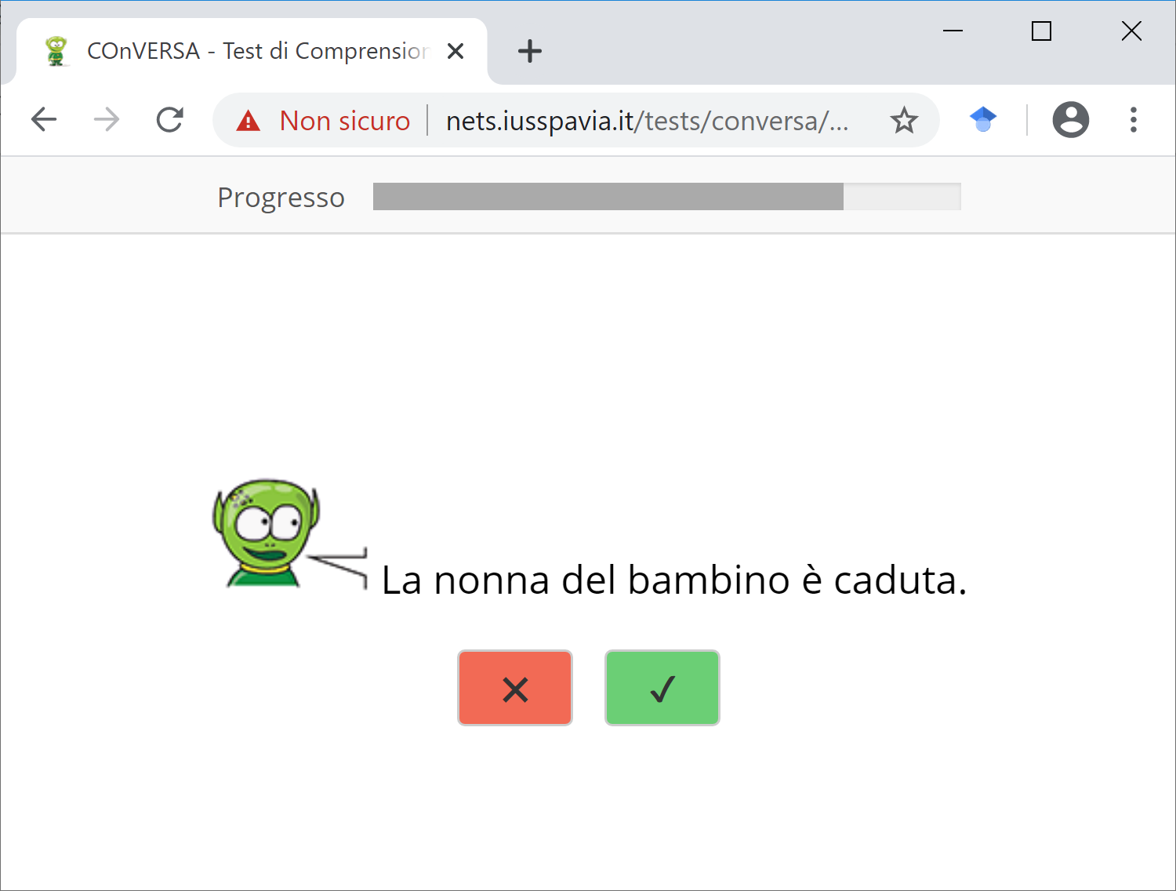
A proposal: COnVERSA Test di Comprensione delle Opposizioni morfo-sintattiche VERbali attraverso la ScritturA
Computer-based version:
Paper & pencil version:
Version 3 (grammaticality judgments)

Slide 8
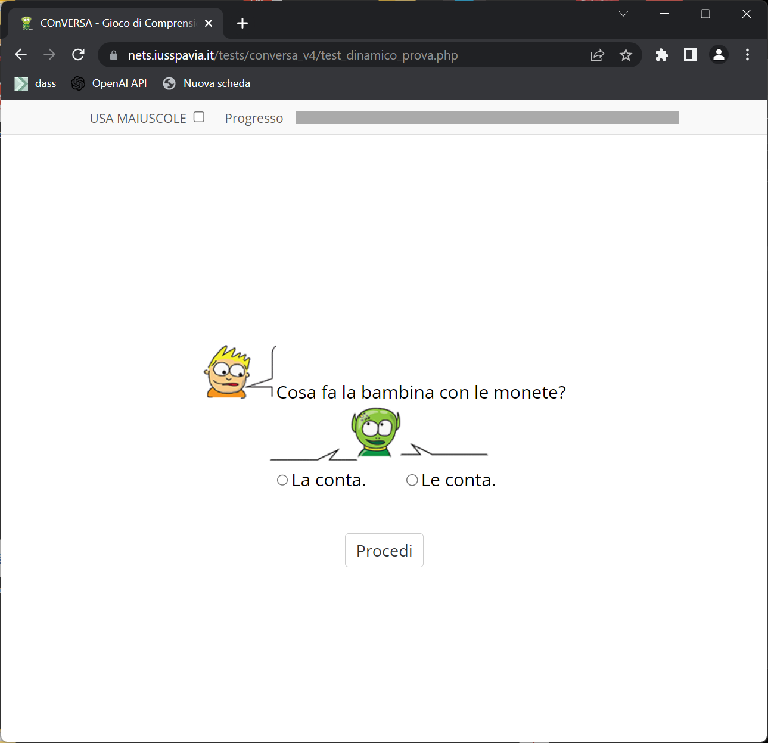
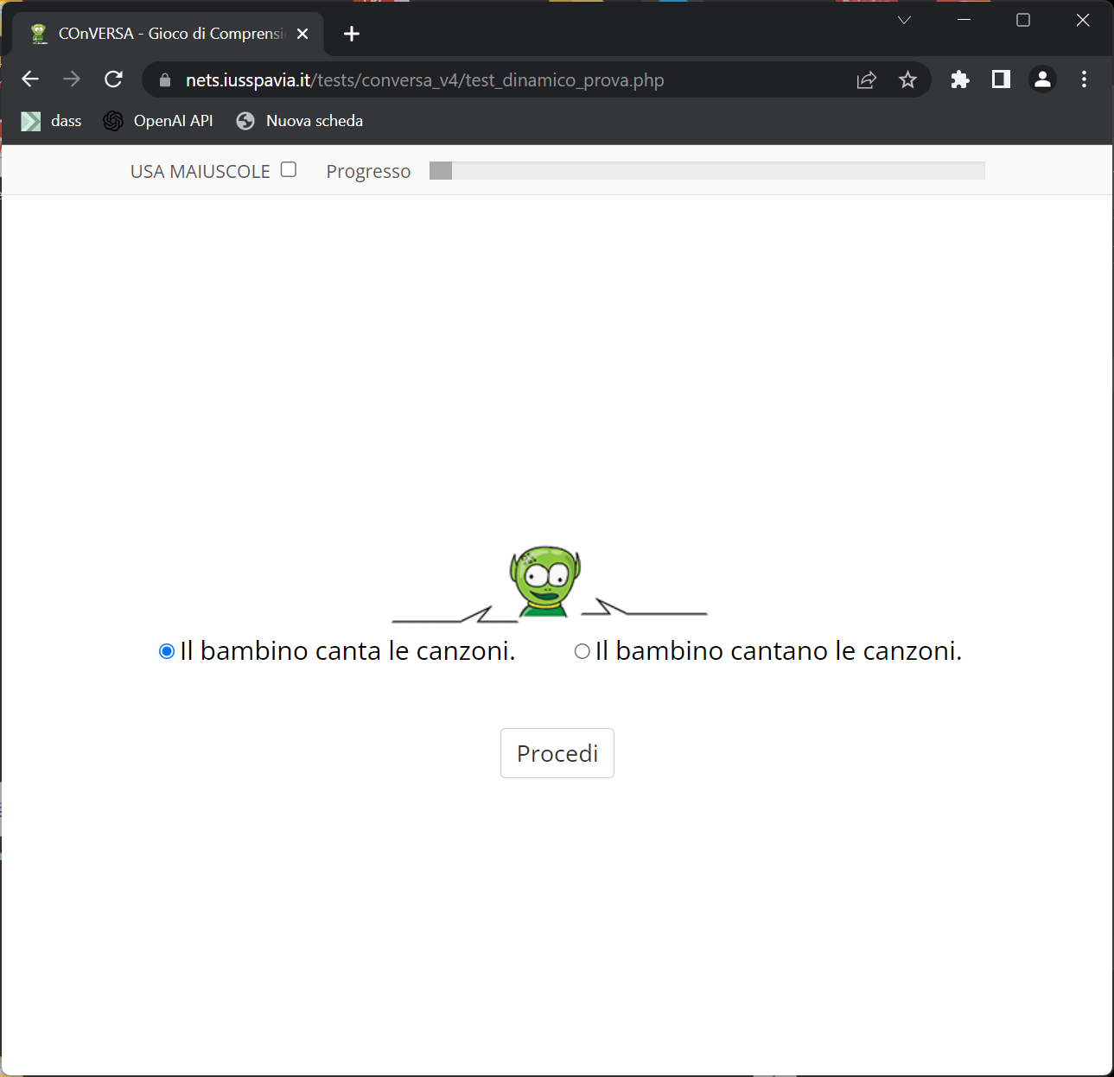
A proposal: COnVERSA Test di Comprensione delle Opposizioni morfo-sintattiche VERbali attraverso la ScritturA
Computer-based version:
Version 4 (forced choice)

Slide 9
The linguistic rational behind COnVERSA
One Merge
Merge + Move (e.g. Subj-V agreement, VP -> IP)
DP
la the.sg.f
mela apple.sg.f
Focus on Agreement
IP
I
VP
V
Gianni_{j} John.sg
parl_{i}-a speak-s.3p.sg
t_{j}
t_{i}

Slide 10
The linguistic rational behind COnVERSA
Object clitic-past participle agreement (double VP -> IP + AgrO/AgrS)
Gianni l’ha vista
John has seen it/her
IP
I
Gianni_{i} John.sg
l_{k}’ha it-CL.sg.f has
AgrO
Focus on Agreement
vist_{j}-a see-n.3p.sg
VP
t_{j}
V
t_{i}
t_{k}

Slide 11
The linguistic rational behind COnVERSA
Complexity is related to the height of the functional layers involved and to the “distance” of the dependency (Moscati & Rizzi 2013):
simple merge-based agreement (DP/NP)
<
movement-based Subj-V agreement (VP -> IP)
<
object clitic-past participle agreement (double VP -> IP + AgrO/AgrS)
Growing trees (Friedmann et al. 2021)
Stage 1 Stage 2 Stage 3 [_{IP} [_{VP}]] [_{QP} [_{ModP} [_{FinP} [_{IP} [_{VP}]]]]] [_{Force} [_{Int} [_{Top} [_{QP} [_{ModP} [_{FinP} …]]]
A complexity metric assigning a synthetic value (from 1 to 10) to each item/block based on the height of the functional level involved (the higher -> the more complex) and the locality of the dependency (Chesi & Canal 2019)

Slide 12
Minimal pairs in COnVERSA
A1. D-N Il giorno. *I giorno. the.sg.m day.sg.m the.pl.m day.sg.m
A2. Subject-Adjectival Predidate Il muro è rosso. *Il muro è rossa the wall.sg.m is red.sg.m the wall.sg.m is red.sg.f
A3. Subject-Verb La maestra corre *La maestra corrono (Unergative) the teacher runs the teacher run Arriva la maestra *Arriva le maestre (Unaccusative) (there) arrives the teacher (there) arrives the teachers Il maestro corregge i compiti *Il maestro correggono i compiti (Trans.) The teacher corrects the homework.pl The teacher correct the homework.pl
A4. Attraction Il muro della casa è rosso. *Il muro della casa è rossa the wall.sg.m of the house.sg.f is red.sg.m the wall.sg.m of the house.sg.f is red.sg.f La maestra degli alunni corre *La maestra degli alunni corrono The teacher of the students runs The teacher of the students run
A5. Past Participle La foglia è caduta *La foglia è cadute the leaf.sg.f is fallen.sg.f the leaf.sg.f is fallen.pl.f
A. Agreement & Inflection
A1. D-N
A2. Subj-Adj Pred
A3. Subj-Verb
A4. Attraction
A5. Past-Participle
A6. Psych verbs
A7. Comulative agreement

Slide 13
Minimal pairs in COnVERSA
A6. Psych verbs A Gianni piacciono i gelati *A Gianni piace i gelati To John like the ice creams To John likes the ice creams "John likes ice creams" Il compito preoccupa gli studenti *Il compito preoccupano gli studenti The homework worries the students The homework worry the students
A7. Cumulative Gianni e io andiamo al mare *Gianni e io vado al mare John and I go.1p.pl to the beach John and I go.1p.sg to the beach
A. Agreement & Inflection
A1. D-N
A2. Subj-Adj Pred
A3. Subj-Verb
A4. Attraction
A5. Past-Participle
A6. Psych verbs
A7. Comulative agreement

Slide 14
Minimal pairs in COnVERSA
B1. Argumental structure Il libro cade dal tavolo. *Il libro cade il tavolo. the.sg book.sg falls off the table the.sg book.sg falls the table Il nonno prende il cappello dall'armadio *Il nonno prende ∅ dall'armadio. The granpa takes the hat from the closet. The granpa takes from the closet
B2. Auxiliary selection Il gatto ha giocato. *Il gatto è giocato. the cat has played the cat is played
B3. Passive diathesis Il cuoco è stato riconosciuto dal ragazzo. The chef has been recognized by the boy *Il cuoco ha riconosciuto dal ragazzo. The chef has recognized by the boy
B. Thematic roles
B1. Argumental structure
B2. Auxiliary selection
B3. Passive diathesis

Slide 15
Minimal pairs in COnVERSA
C1. I and II person pronoun rotation Cosa fai? What do you do? Mangio. *Mangi. (I) eat.1p.sg (You) eat.2p.sg
C2. Reflexives Il ragazzo scivola. *Il ragazzo si scivola. The boy slips. The boy himself slips. II pittore si preoccupa del quadro. *II pittore ∅ preoccupa del quadro. The painter himself worries about the painting "The painter is worried about the painting"
C3. Clitics La nonna disegna un albero e lo colora. *La nonna disegna un albero e gli colora. The granma draws a tree and it/to_it paints. Il nonno vede la bambina e le compra un gelato. * Il nonno vede la bambina e la compra un gelato. The granpa sees the child and her/to_her buys a ice cream.
C. Pronouns
C1. I and II person pronouns
C2. Reflexives
C3. Clitics

Slide 16
Minimal pairs in COnVERSA
D1. Questions on modifiers/adjuncts Dove dorme il ragazzo? Where does the child sleep? In camera. *Di notte. In the beedroom At night
D2. Questions on arguments Chi mangia? Who eats? La mamma. *La pasta. Mom Pasta Cosa mangia? What (does (s)he) eat? La pasta. *La mamma. Pasta Mom
D3. Polar questions La bambina sogna? (Does) the child dream? Sì. *Una torta. Yes A cake
D. Questions
D1. Questions on modifiers/adjuncts
D2. Questions on arguments
D3. Polar questions
D4. Why questions
D5. Questions on subject/object relatives
Notes:
Where, When…

Slide 17
Minimal pairs in COnVERSA
D4. Why questions Perché il bambino dorme? Why does the child sleep? Perché è tardi. *No. Because (it) is late No Perché il ghiaccio si scioglie? Why does the ice melts? Perché fa caldo. *Fuori dal frigo. Because it is hot Outside the fridge
D5. Questions on subject/object relative clauses Ci sono due bambine. Una corre, l'altra salta e chiama i cugini. Quale bambina salta? There are two children. One runs, the other jumps and calls the cousins. Which one jumps? Quella che chiama i cugini. *Quella che i cugini chiamano. The one who calls the cousins The one who the cousins call Ci sono due maestri. Uno insegna ed è ascoltato dagli studenti, l'altro si riposa. Quale maestro insegna? There are two teachers. One teaches and he’s listened to by the students, the rests. Which one teaches? Quello che gli studenti ascoltano. *Quello che ascolta gli studenti. The one who the students listen to The one who listens to the students
D. Questions
D1. Questions on modifiers/adjuncts
D2. Questions on arguments
D3. Polar questions
D4. Why questions
D5. Questions on subject/object relatives
Notes:
Where, When…

Slide 18
Decision Tree in the dynamic modality
Subject-Verb agreement
Subject-Nominal predicate agreement (local)
D-N agreement
Auxiliary selection + past participle agreement
Argumental structure
Post-Verbal subject agreement
Subject-Nominal predicate agreement (non-local)
Passive/active
Psych verbs
Cliticization
I/II person pronoun rotation
Wh questions
fail
Phenomenon
1
fail
2
pass
5
pass
7
3
fail
pass
3
fail
Estimated complexity
4
pass
6
fail
6
8
pass
9
pass
10

Slide 19
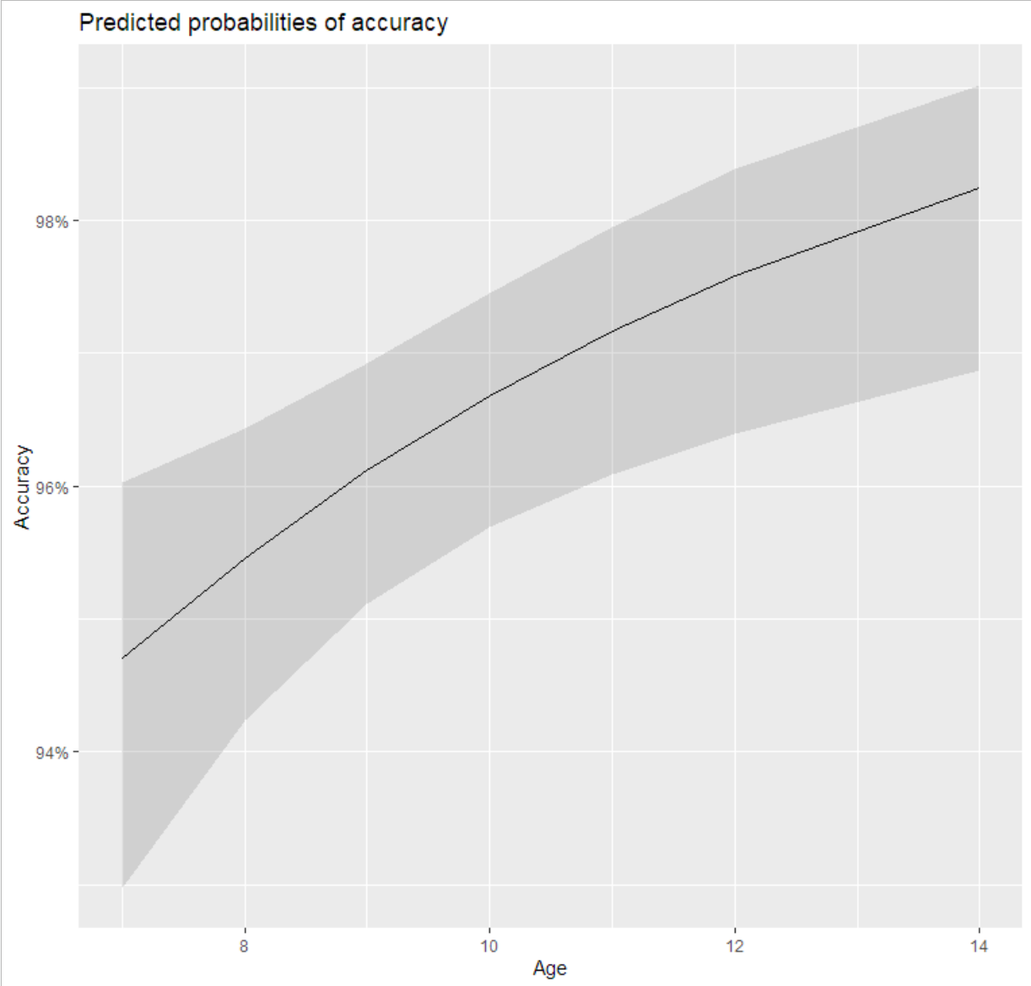
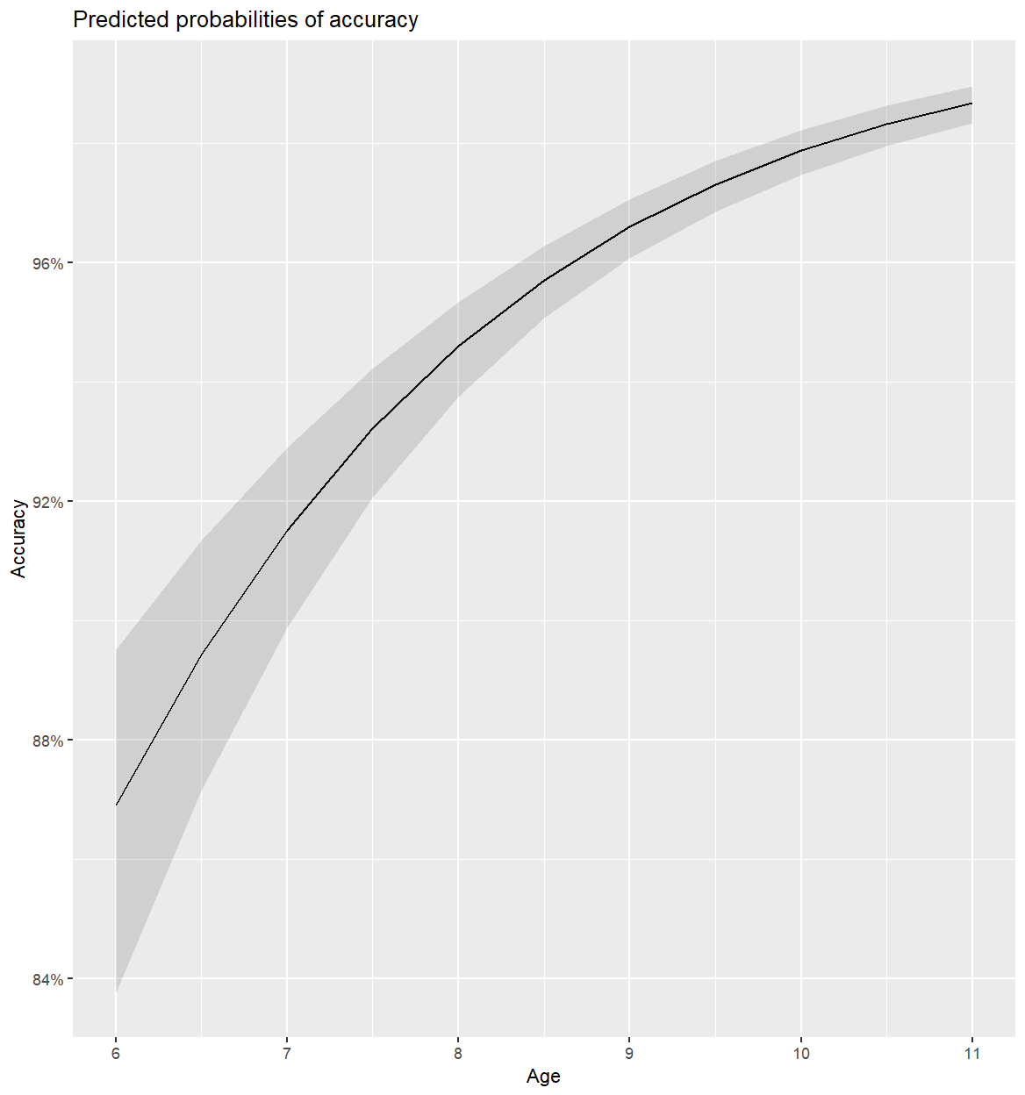
Results (control group)
Age in the control group
Significant Age effect (χ²=8.8239 p=0.003) - Version 3
Significant Age effect (χ²=395.89 p<0.0001) – Version 4
Version 3 87 normally developing Hearing Children (Age range=7-14, M=8.73, SD=1.48)
Version 4 787 normally developing Hearing Children (Age range=6;6-11, M=8.93, SD=1.25)

Slide 20
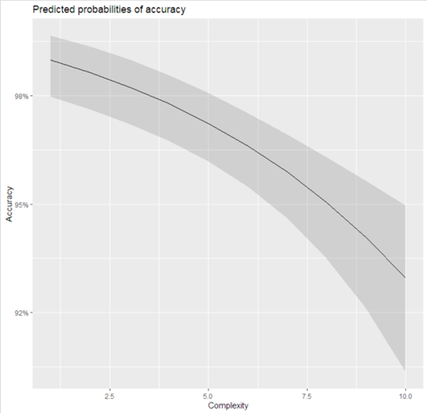
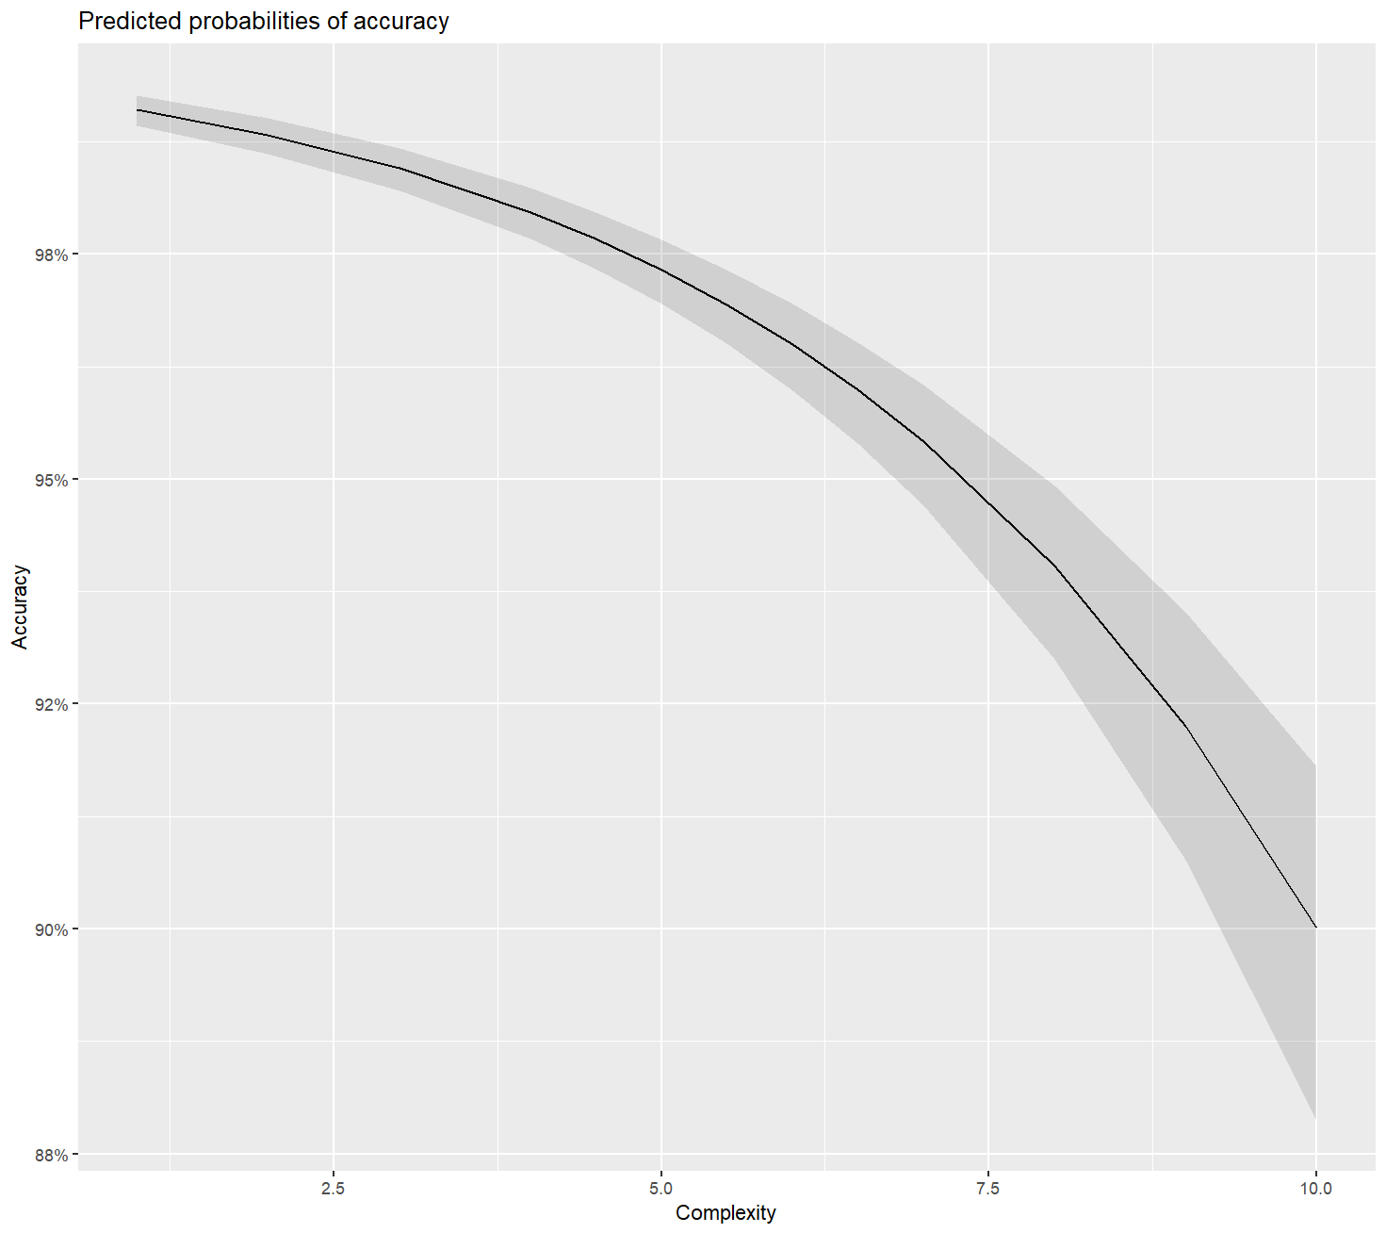
Results (control group)
Estimated Complexity in the control group
Significant Complexity effect (χ²(3)=15.0983 p<0.001) - Version 3
Significant Complexity effect (χ²(3)=906.04 p<0.0001) – Version 4
Version 3 87 normally developing Hearing Children (Age range=7-14, M=8.73, SD=1.48)
Version 4 787 normally developing Hearing Children (Age range=6;6-11, M=8.93, SD=1.25)

Slide 21
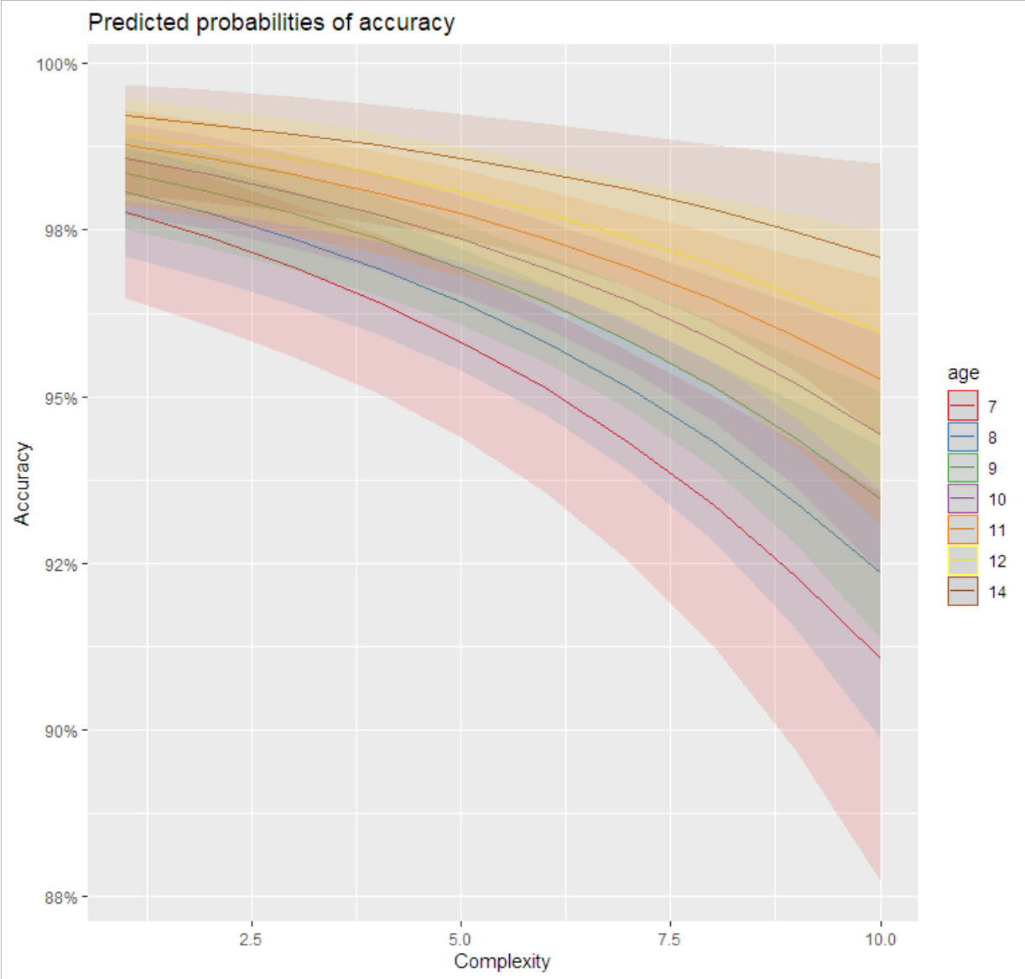
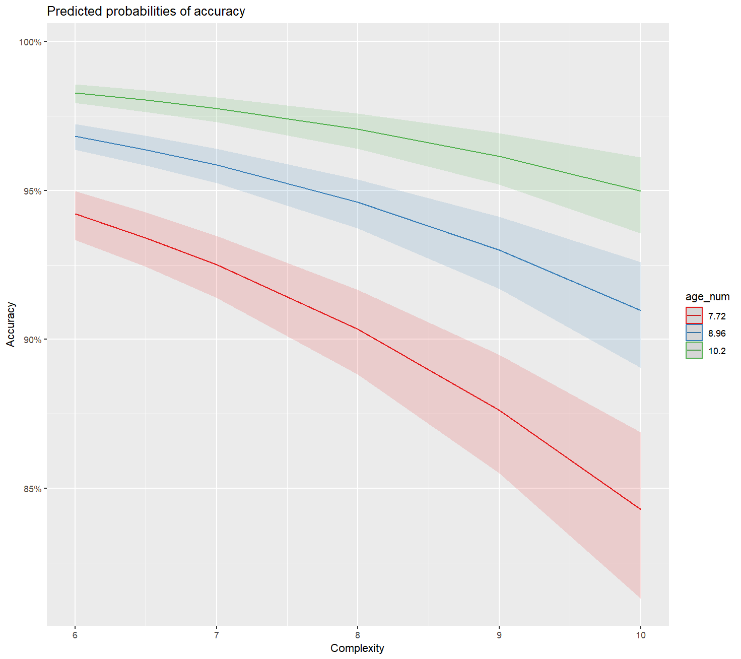
Results (control group)
Age and complexity in the control group
Significant interaction Age X Complexity (χ²(9)=8.8934, p=0.011) - Version 3
Significant interaction Age X Complexity (χ²(9)=364.75, p<0.0001) - Version 4

Slide 22
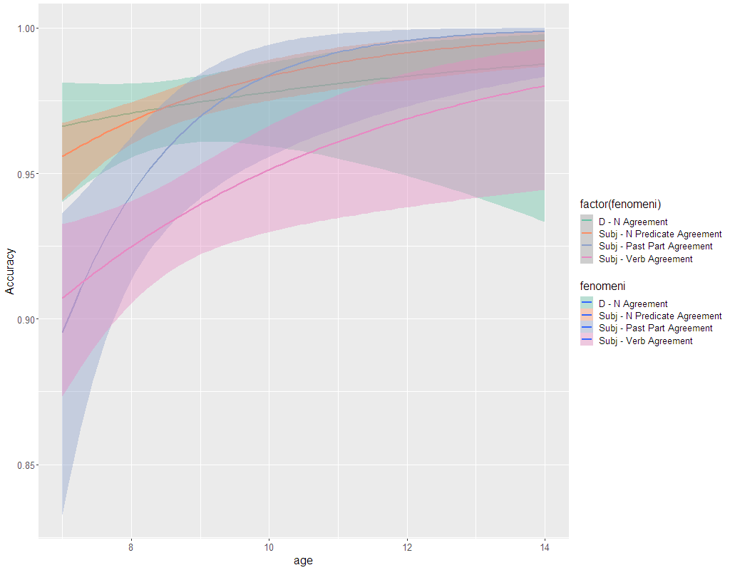
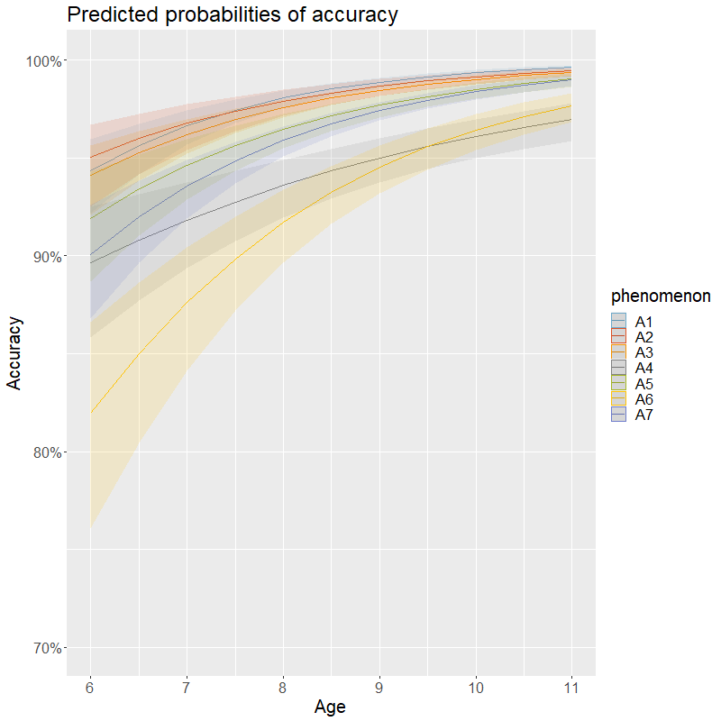
Results (control group)
Significant difference for agreement Type (Ver.3: χ²(9)=22.4445 p<0.001; Ver. 4: χ²(9)= 1452.3, p<0.0001)
Significant interaction of agreement Type X Age (Ver. 3: χ²=18.4920, p=0.018; Ver. 4: χ²(15)=304.1 p<0.0001)
A1 D-N ≅ A2 S-AP A4 Attraction ≅ A6 Psych V, A5 Past Part ≅ A7 Cumulative
D-N Vs. Subject-Verb agreement: estimate= 0.7480, SE= 0.152, z=4.924, p<0.0001
A. Agreement & Inflection
A1. D-N
A2. Subj-Adj Pred
A3. Subj-Verb
A4. Attraction
A5. Past-Participle
A6. Psych verbs
A7. Comulative agreement
Notes:
$emmeans
phenomenon emmean SE df asymp.LCL asymp.UCL
A1 5.09 0.150 Inf 4.79 5.38
A2 5.68 0.231 Inf 5.23 6.13
A3 4.34 0.103 Inf 4.14 4.54
A4 2.77 0.119 Inf 2.54 3.00
A5 3.93 0.143 Inf 3.64 4.21
A6 2.73 0.124 Inf 2.49 2.98
A7 3.84 0.110 Inf 3.63 4.06

Slide 23
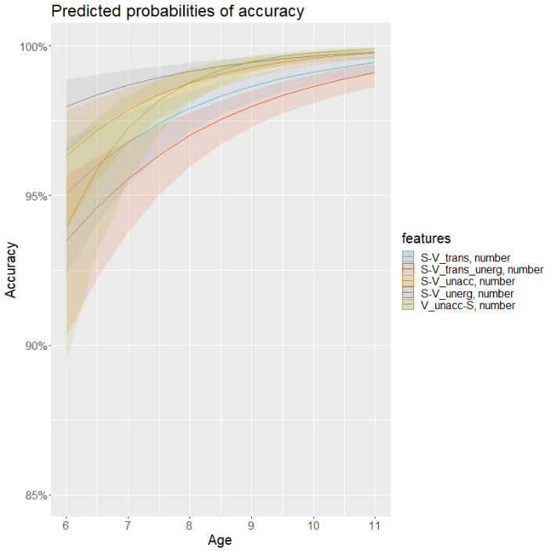
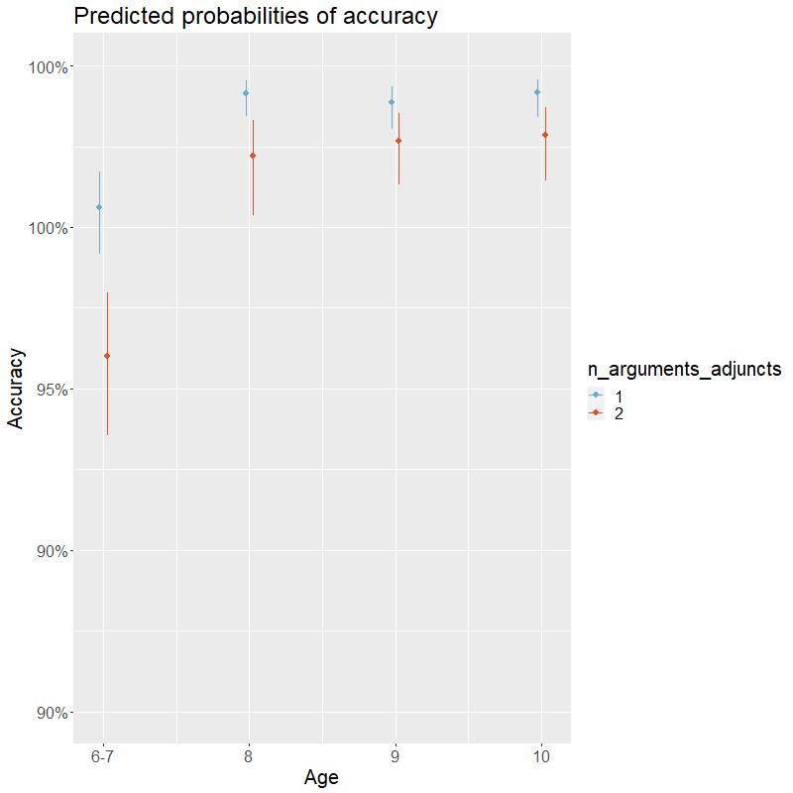
Results (control group)
Significant interaction in Subj-Verb type between predicate type and Age (Ver. 4: χ²(19)=138.296, p<0.0001)
Transitives < Unaccusatives and Unergatives
Unaccusatives with post-V subjects ≅ Unaccusatives and Unergatives with pre-V subjects
The number of arguments is the significant factor, interacting also with age group (χ²(39)=75.571, p=0.0004): until age 9, 1-arg predicates > 2-arg predicates
A. Agreement & Inflection
A1. D-N
A2. Subj-Adj Pred
A3. Subj-Verb
A4. Attraction
A5. Past-Participle
A6. Psych verbs
A7. Comulative agreement

Slide 24
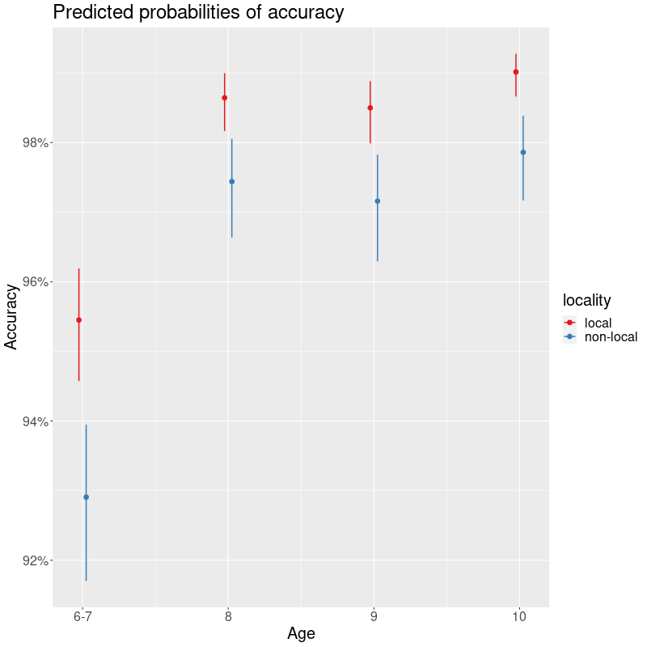
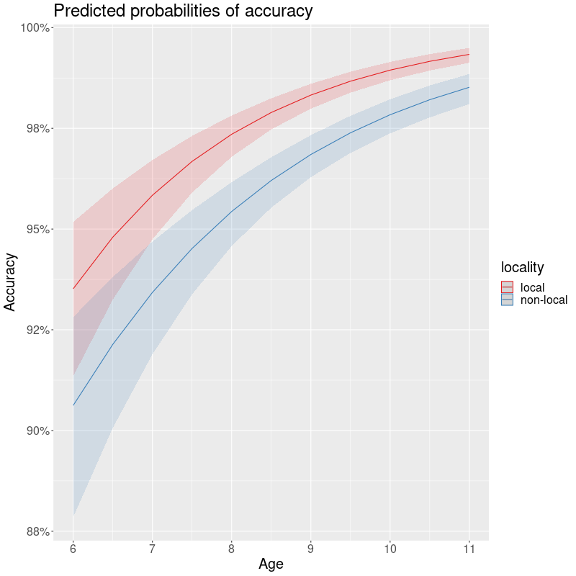
Results (control group)
Attraction in Agreement
Significant locality X age effect (χ²(6)=100.78 p<0.0001)
A1. D-N
A2. Subj-Adj Pred
A3. Subj-Verb
A4. Attraction
A5. Past-Participle
A6. Psych verbs
A7. Comulative agreement

Slide 25
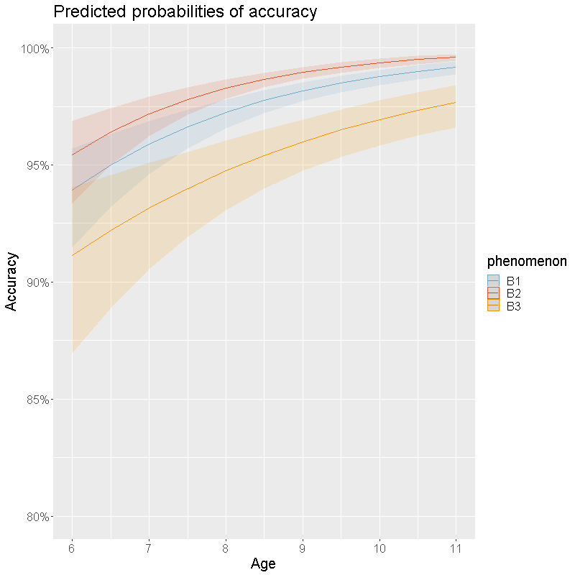
Results (control group)
Significant age X argument structure type interaction (χ²(5)=108.786, p<0.0001)
B2 > B3
B1 ≤ B2 (significant in 7-8 y.o. children)
B. Thematic roles
B1. Argumental structure
B2. Auxiliary selection
B3. Passive diathesis

Slide 26
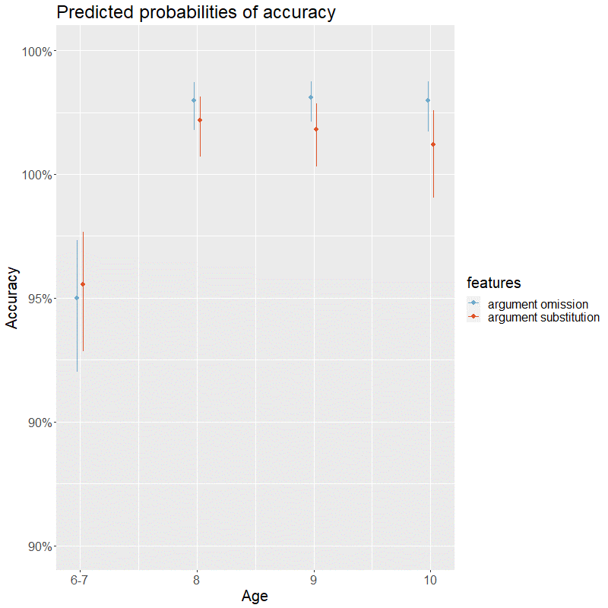
Results (control group)
Significant age_group X features interaction (χ²(4)=18.1994, p=0.001)
B. Thematic roles
B1. Argumental structure
B2. Auxiliary selection
B3. Passive diathesis

Slide 27
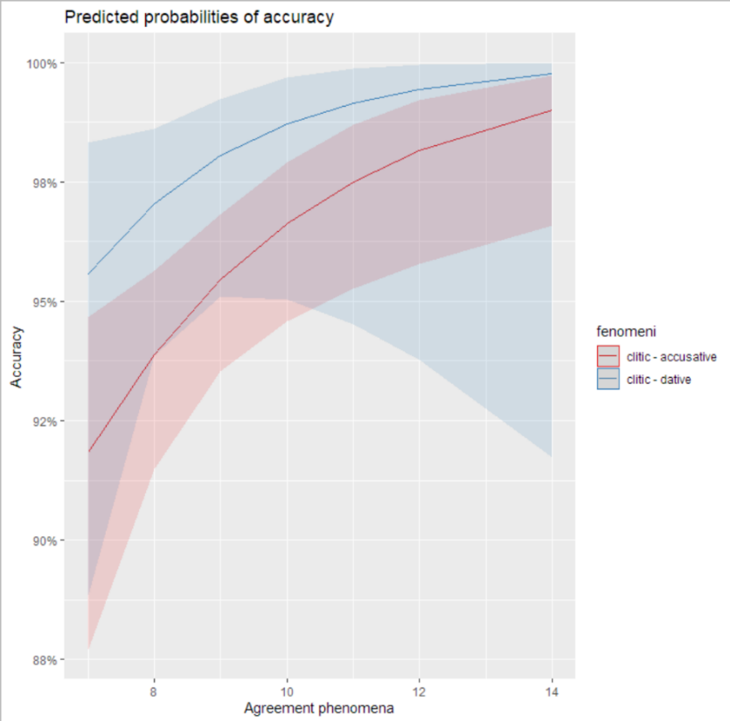
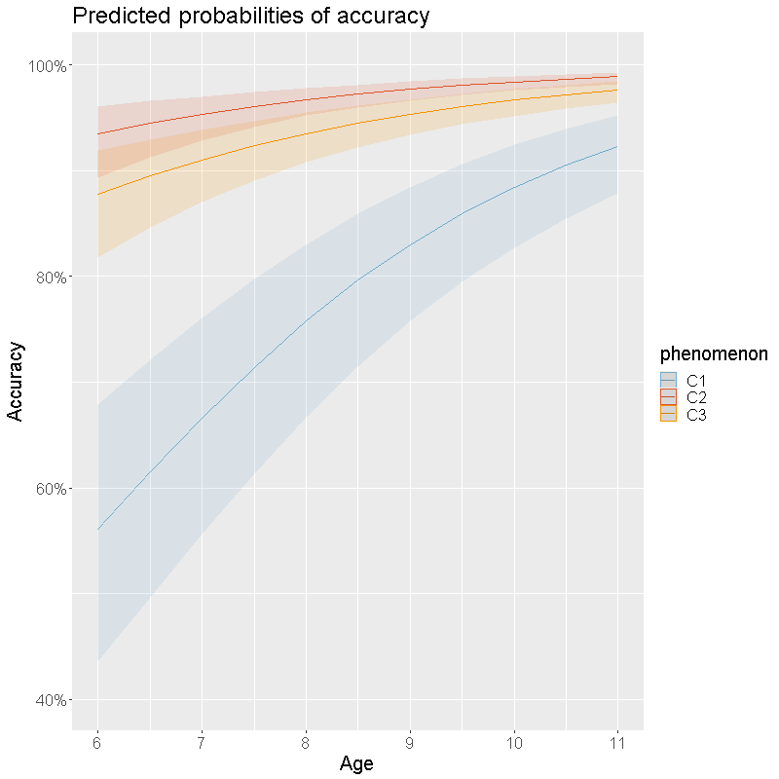
Results (control group)
Clitics
Significant interaction age X type (ver. 3 accusative vs dative) effect (χ²(4)=9.4044, p=0.009). ver. 4 (χ²(18)=123.82, p<0.0001)
C2 - C3: estimate=0.744, SE=0.257, z=2.901, p=0.0104
C. Pronouns
C1. I and II person pronouns
C2. Reflexives
C3. Clitics

Slide 28
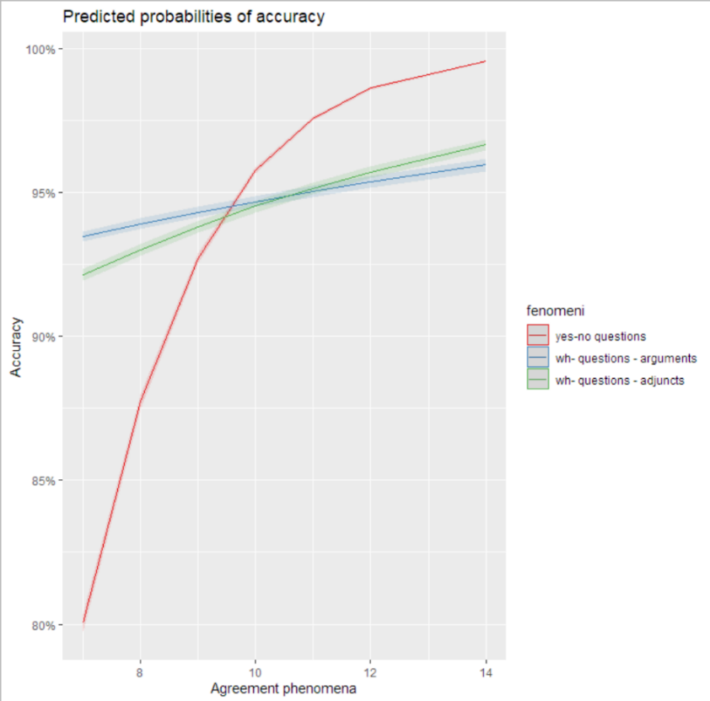
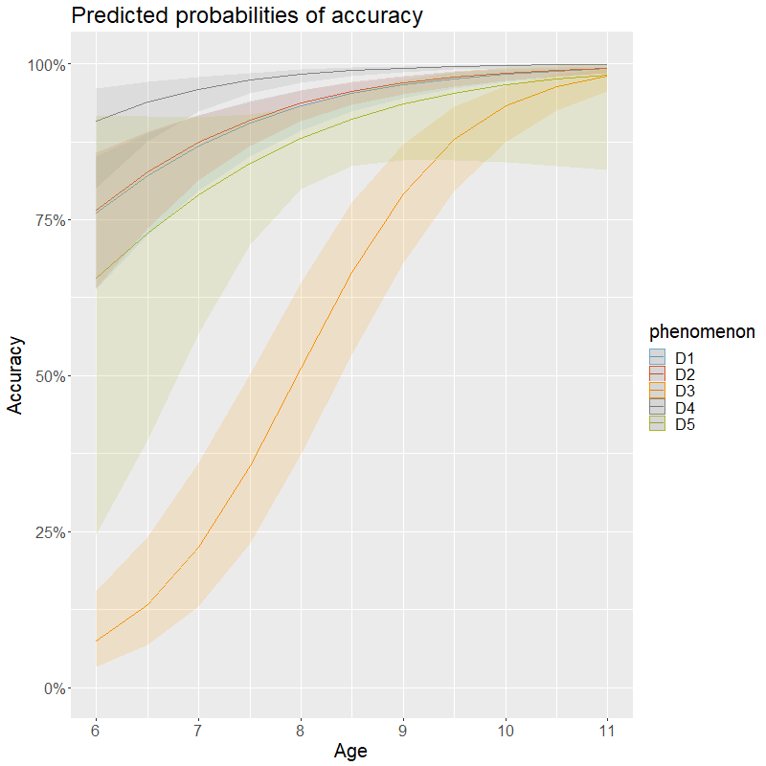
Results (control group)
A tendential interaction age X type (yes-no questions vs wh- arguments vs wh- adjuncs) effect in version 3 (χ²(3)=7.2862, p=0.06331). A strong interaction in version 4 (χ²(45)=201.44, p<0.0001)
D1 wh- adjuncts ≅ D2 wh- arguments
object RC - subject RC estimate:-1.75, SE=0.608, z=-2.874, p<0.0041
D. Questions
D1. Questions on modifiers/adjuncts
D2. Questions on arguments
D3. Polar questions
D4. Why questions
D5. Questions on subject/object relatives

Slide 29
Discussion (control group)
The COnVERSA test is sufficiently sensitive to capture various relevant linguistic phenomena:
Attraction and intervention (Franck et al. 2006, Friedman et al. 2009, Chesi & Canal 2019)
Asymmetries in agreement (Moscati & Rizzi 2014)
Auxiliary selection vs passivization (Belletti & Guasti 2015)
Clitic fragilities (Hyams & Shaeffer 2007, Chesi 2000)
Wh- questions (no difference between arguments and adjuncts) and discrimination between SR and OR in answering (cf. Guasti 1996)

Slide 30
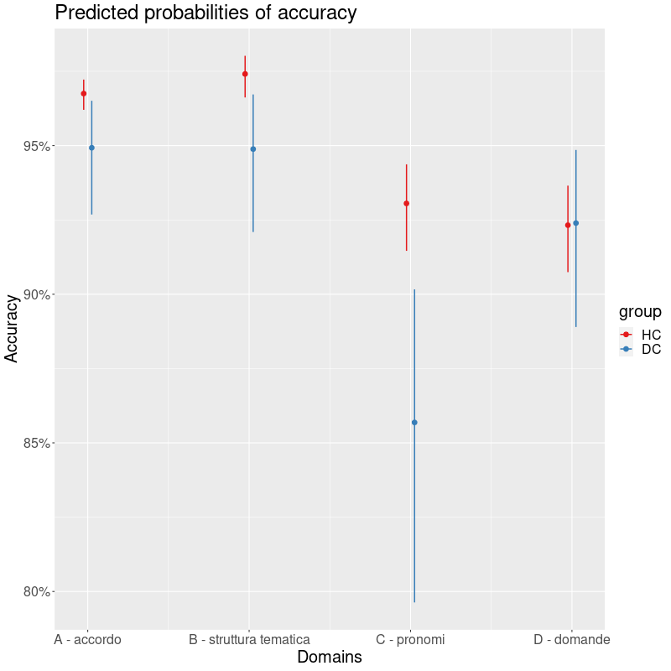
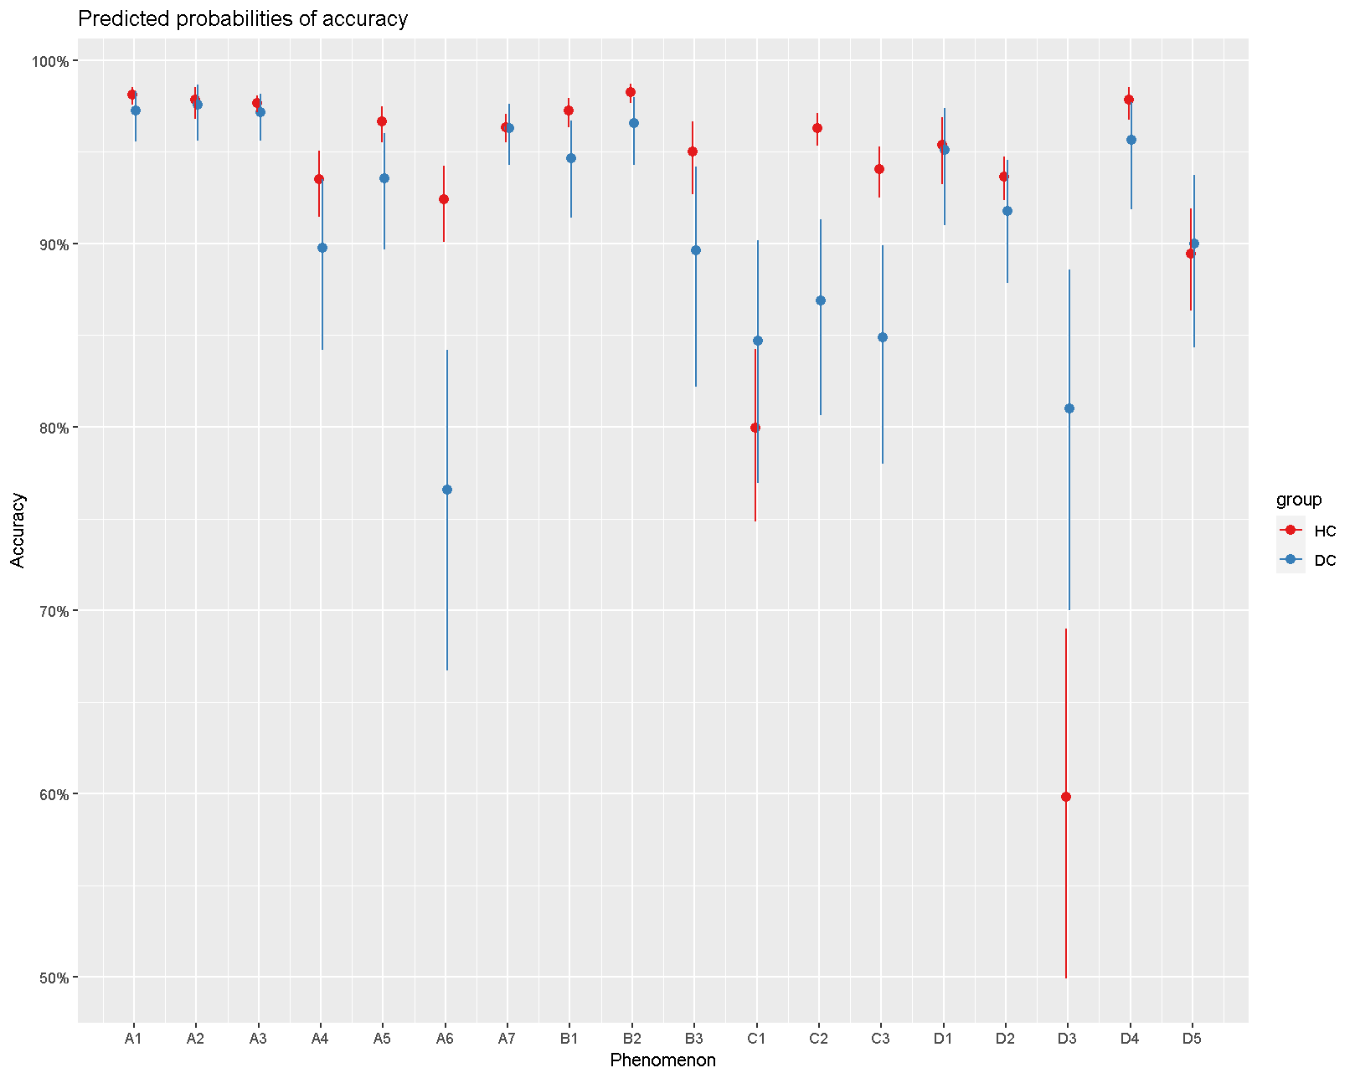
Results (deaf group: 54 subjects; Age range=6.6-72, M=15.84, SD=12.66 )

Slide 31
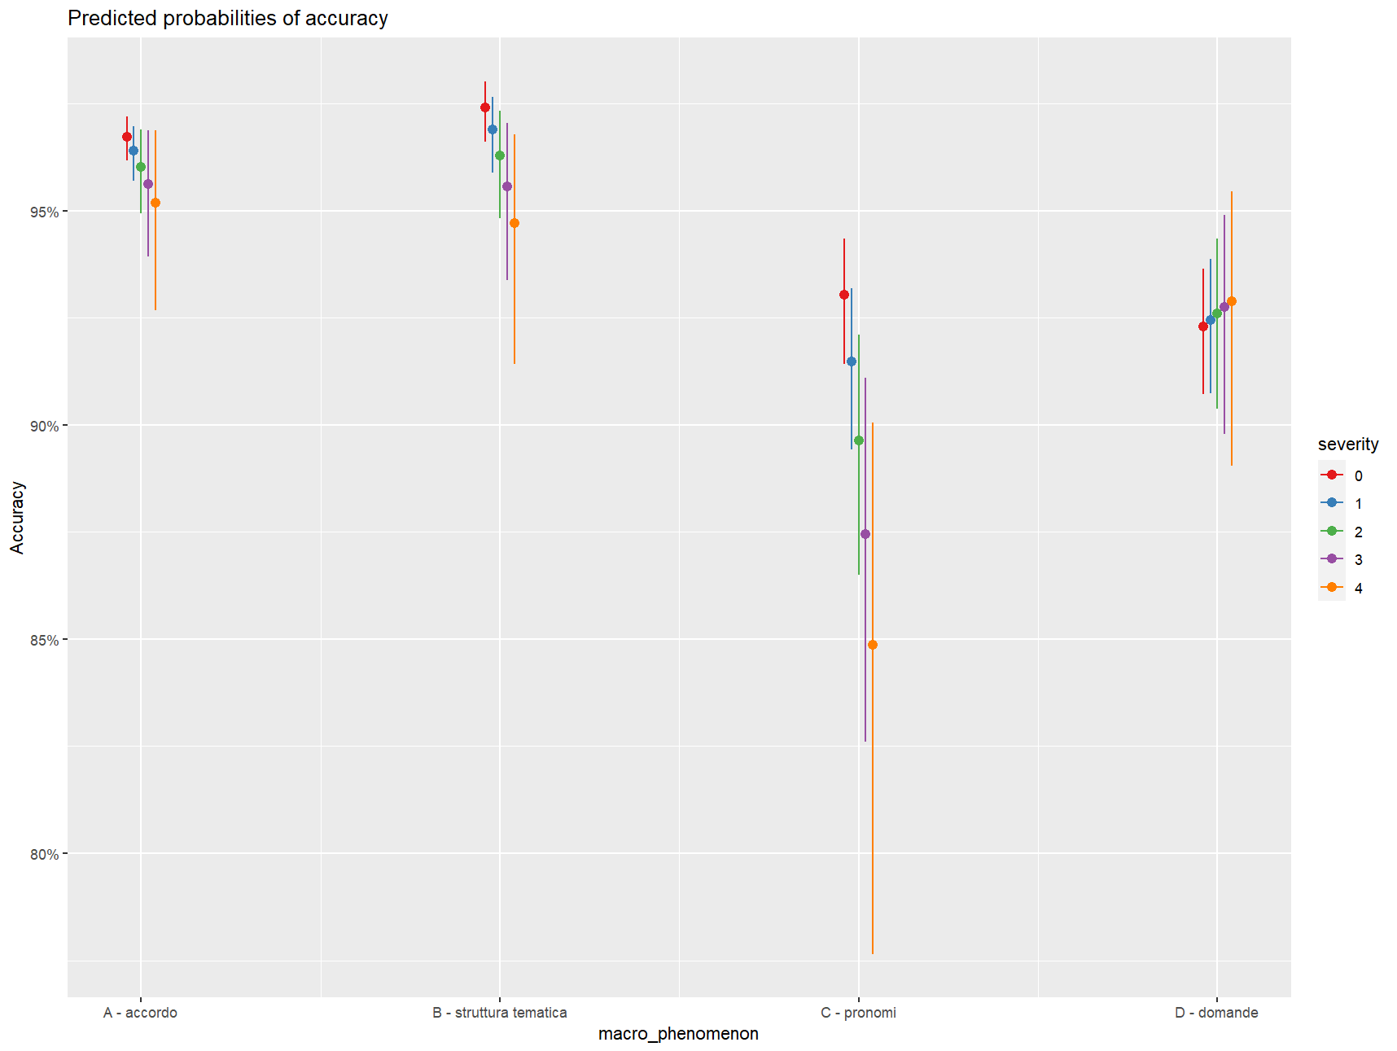
Results (deaf group)
Severity
Tendentially significant (χ²(1)=3.5451, p=0.05), very strong interaction with the tested domain (χ²(4)=26.299, p<0.0001)
Severity
0. Progressive: #1 1. Mild: #2 2. Moderate: #5 3. Severe: #8 4. Profound: #38

Slide 32
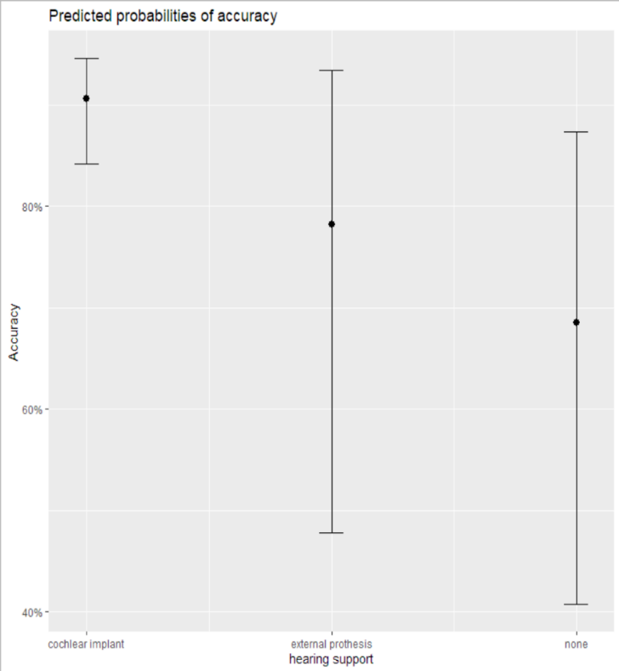
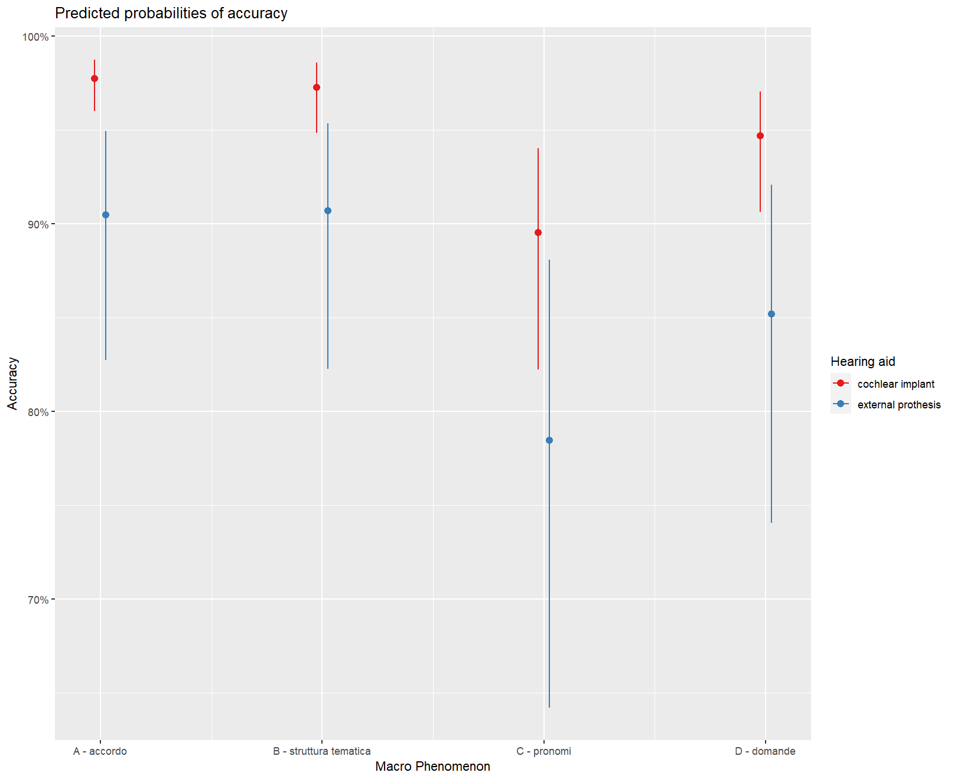
Results (deaf group)
Hearing aid
Tendentially significant effect of hearing aid in Version 3 (χ²=7.7339, p=0.080)
Strongly significant correlation of hearing aid x tested domain in Version 4 (χ²(6)=36.10, p<0.0001)
Hearing aid
Cochlear implant: #32 External prothesis: #22

Slide 33
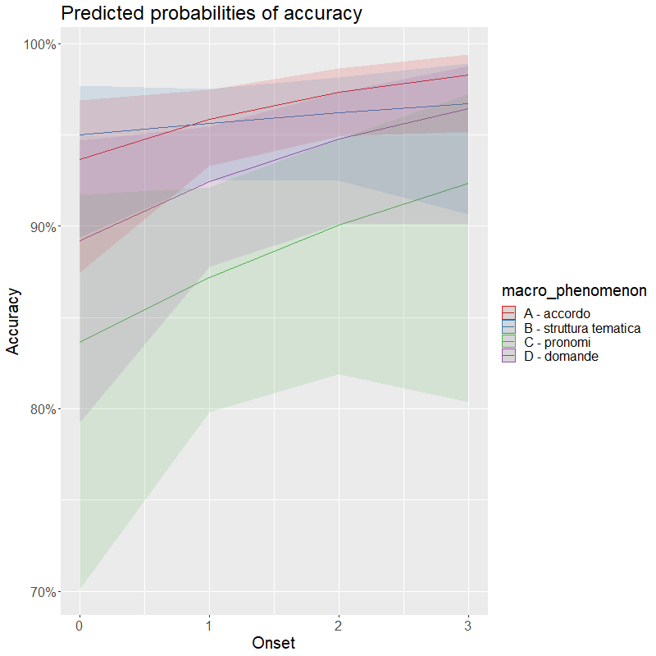
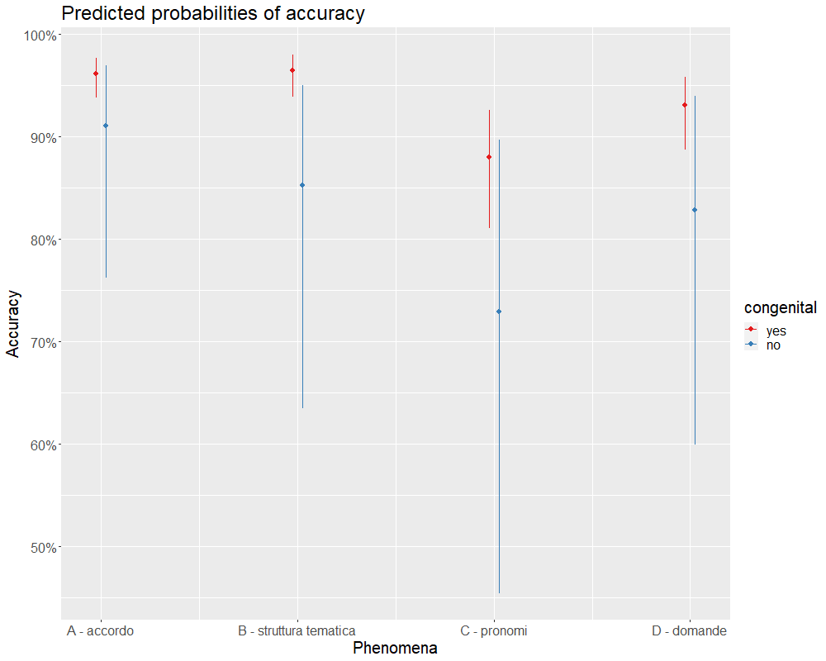
Results (deaf group)
Onset and Congenital are not significant factors
A mildly numerical interaction trend onset x domain tested emerge
A significant interaction emerges congenital x domain tested (χ²(4)=14.65, p<0.005)
Onset birth: #13 before 1 y.o.: #25 before 2 y.o.: #3 before 3 y.o.: #8
Congenital yes: #46 no: #8

Slide 34
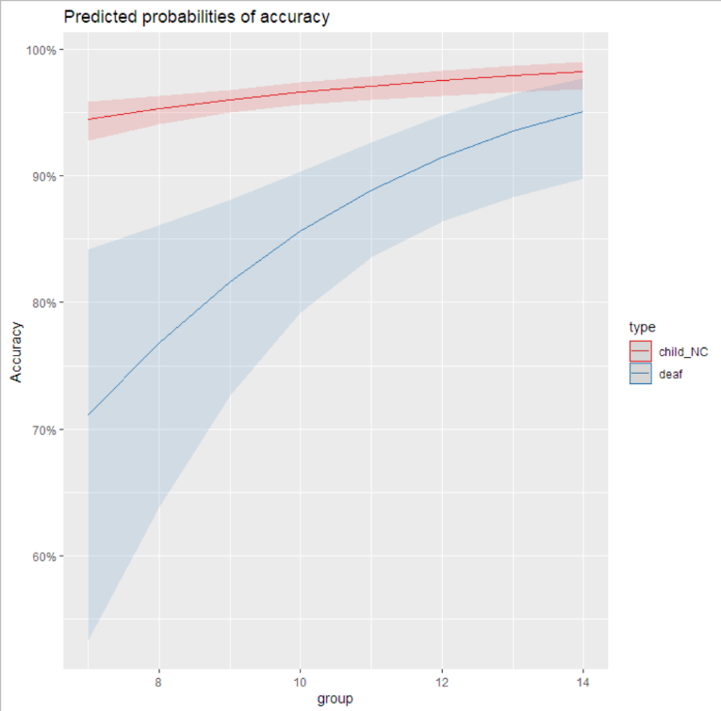
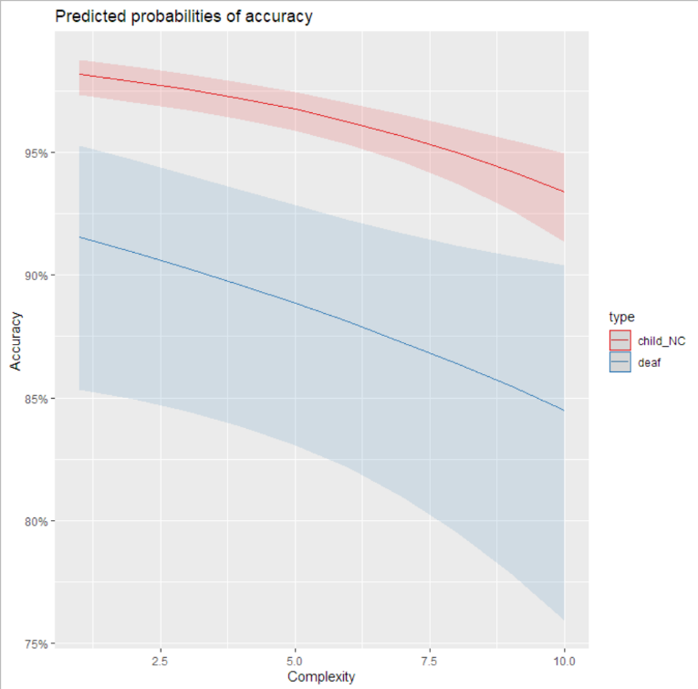
Results (deaf group)
Age and complexity in comparison with the HC group
34 deaf children (Age range=7-14, M=10.9, SD=2.14, all profound or severe deafness)
Strongly significant group effect (χ²=20.149, p<0.001)
Relatively significant age effect (χ²=5.396, p=0.020)
Strongly significant complexity effect (χ²=15.098, p<0.001)

Slide 35
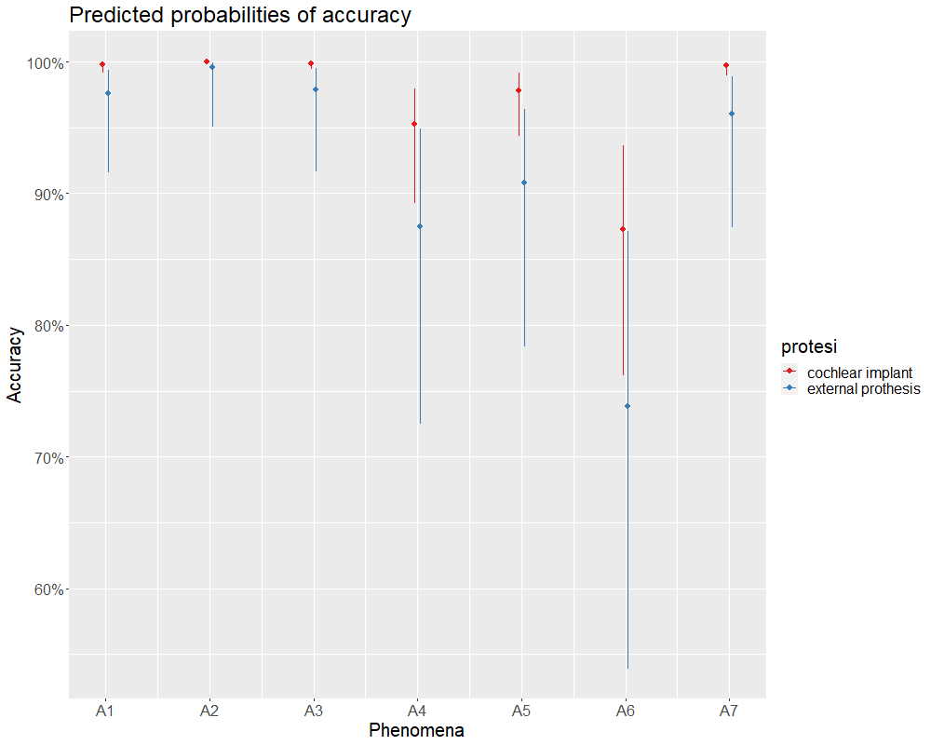

Results (deaf group)
Agreement
Strongly significant agreement type main effect and Hearing aid x agreement type interaction (χ²(9)= 61.326, p<0.0001)
HC: A1 ≅ A2, A4 ≅ A6, A5 ≅ A7
DC-CI: A1 ≅ A2 ≅ A3 ≅ A7
DC-EP: A1 ≅ A2 ≅ A3 ≅ A4 ≅ A5 ≅ A7
DC-CI A1, A2, A3, A7 > DC-EP A2, A1, A2, A3, A7
A. Agreement & Inflection
A1. D-N
A2. Subj-Adj Pred
A3. Subj-Verb
A4. Attraction
A5. Past-Participle
A6. Psych verbs
A7. Comulative agreement
HC

Slide 36
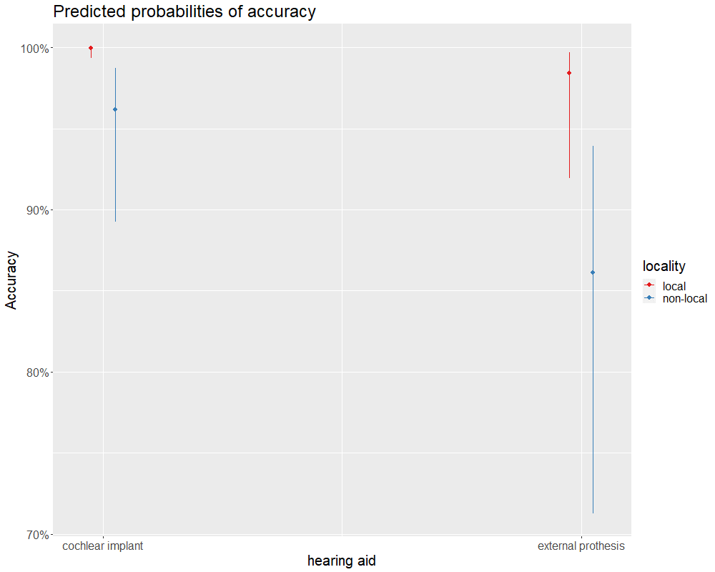
Results (deaf group)
Attraction and Agreement
Significant locality effect (χ²(3)=109.019, p = 0.003), but no interaction with hearing aid
A. Agreement & Inflection
A1. D-N
A2. Subj-Adj Pred
A3. Subj-Verb
A4. Attraction
A5. Past-Participle
A6. Psych verbs
A7. Comulative agreement
HC
Notes:
Evolution: A theory able to predict language changes is favored.
Computational Efficiency:

Slide 37
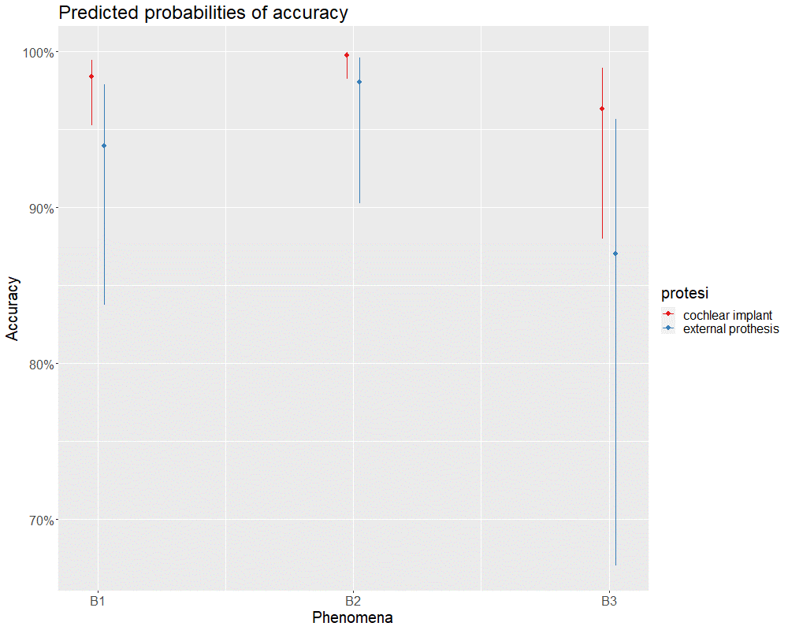
Results (deaf group)
Thematic roles
Mild hearing aid effect (χ²(5)=9.8112, p=0.0807)
B. Thematic roles
B1. Argumental structure
B2. Auxiliary selection
B3. Passive diathesis
HC
Notes:
Evolution: A theory able to predict language changes is favored.
Computational Efficiency:

Slide 38
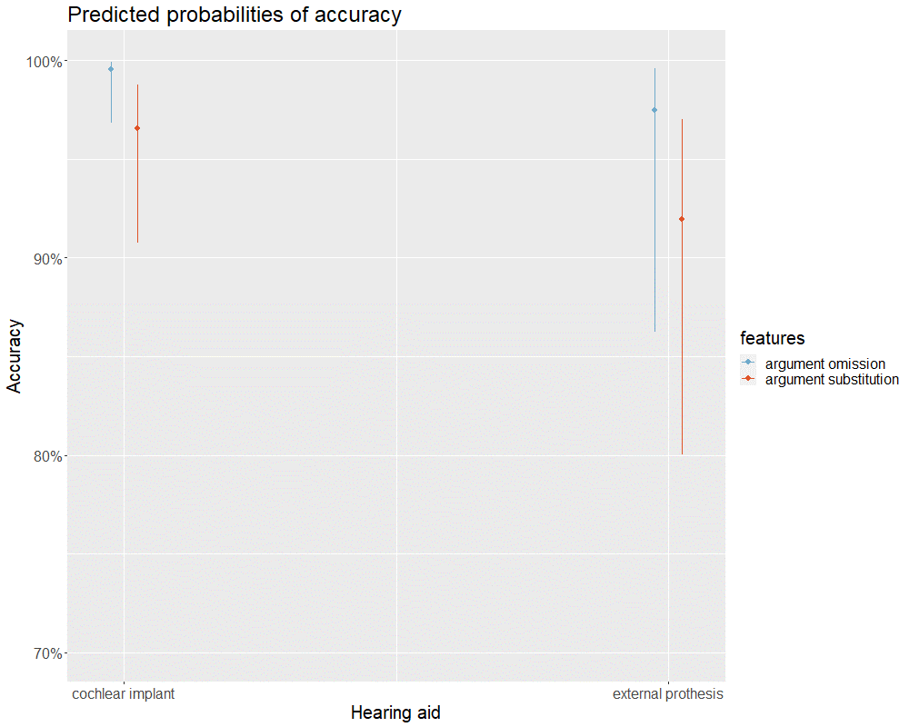
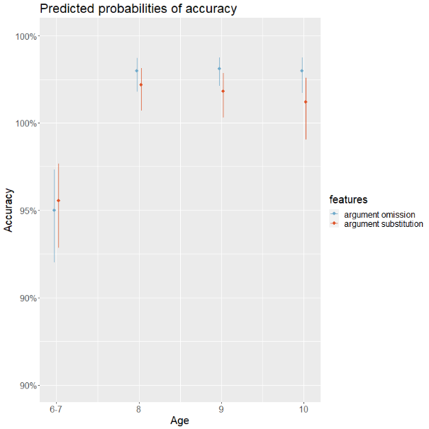
Results (deaf group)
Thematic roles
No sensitivity to argument omission vs substitution
B. Thematic roles
B1. Argumental structure
B2. Auxiliary selection
B3. Passive diathesis
HC
Notes:
Evolution: A theory able to predict language changes is favored.
Computational Efficiency:

Slide 39
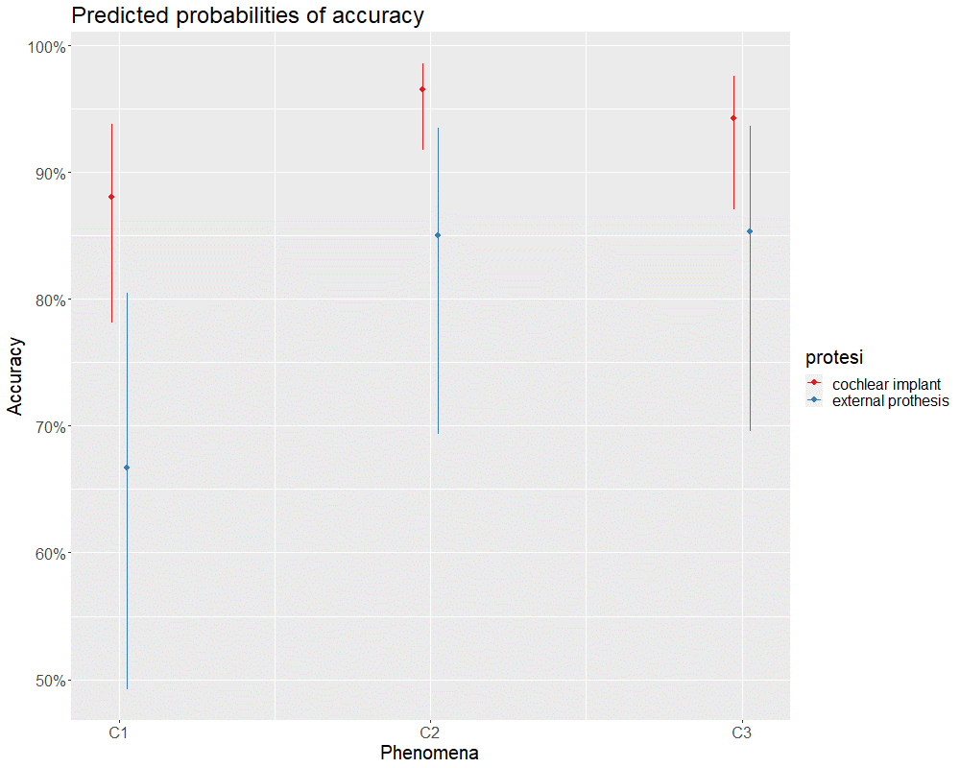
Results (deaf group)
Pronouns
Strongly significant type main effect and Hearing aid X type interaction (χ²(18)=29.061, p=0.0476)
C. Pronouns
C1. I and II person pronouns
C2. Reflexives
C3. Clitics
HC
Notes:
Evolution: A theory able to predict language changes is favored.
Computational Efficiency:

Slide 40
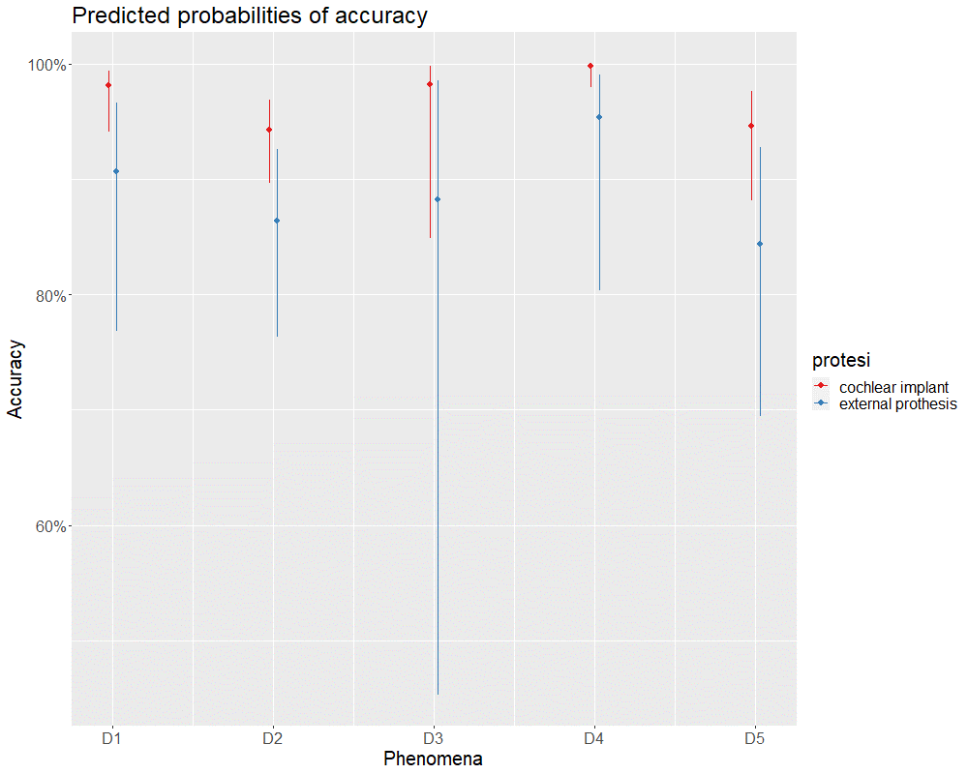
Results (deaf group)
Questions
Strong hearing aid effect (χ²(5)= 19.75, p=0.002)
Mild interaction hearing aid X type (χ² (26)= 198.7103, p=0.092)
SR ≅ OR (in CI: SR - OR estimate=1.512, SE=0.629, z=2.404, p=0.1547)
D. Questions
D1. Questions on modifiers/adjuncts
D2. Questions on arguments
D3. Polar questions
D4. Why questions
D5. Questions on subject/object relatives
HC
Notes:
Evolution: A theory able to predict language changes is favored.
Computational Efficiency:

Slide 41
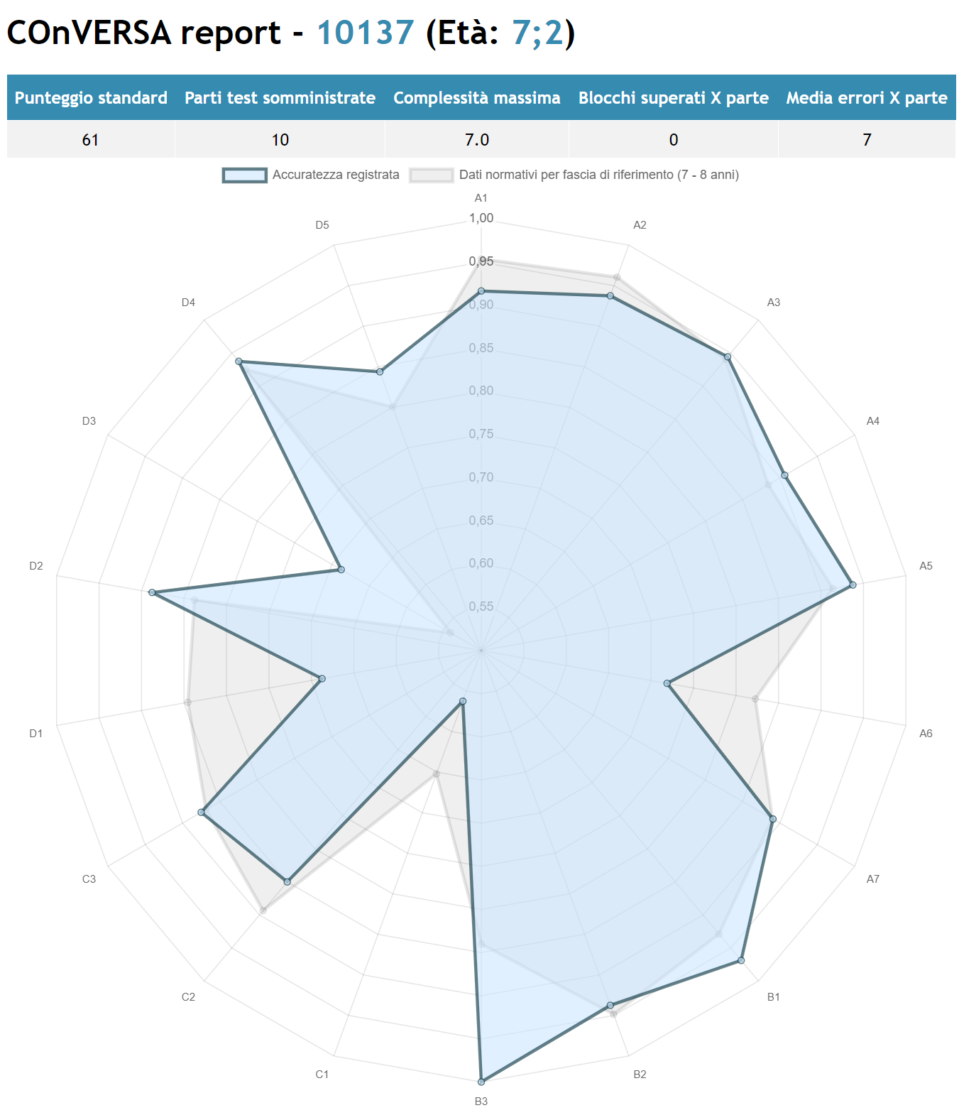
Standard Report
Hearing Child

Slide 42
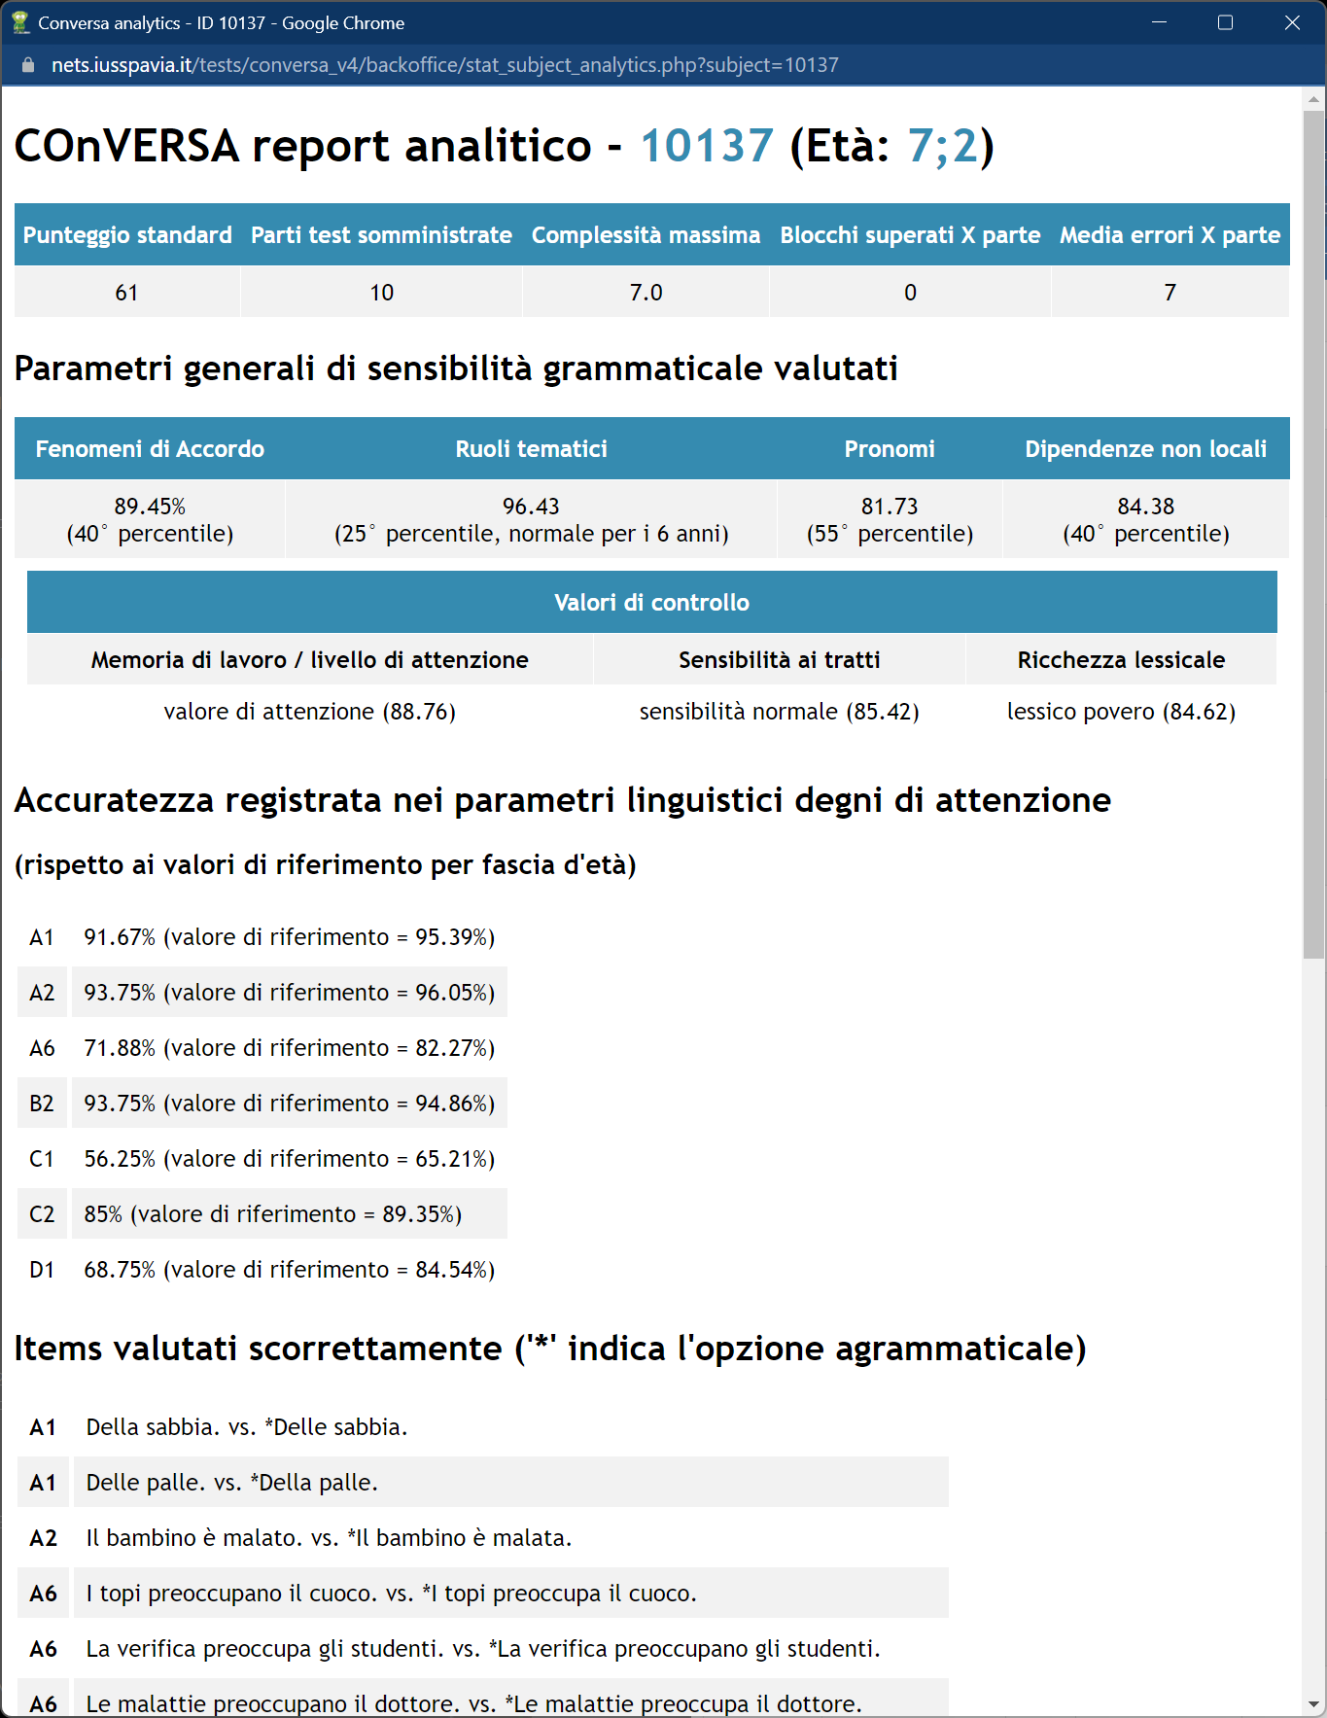
Detailed Report
Features sensitivity: discrimination between local and non-local dependencies
Vocabulary: rt of items including less frequent words
Working memory: performance on items with more than 1 DP or PP
Hearing Child

Slide 43
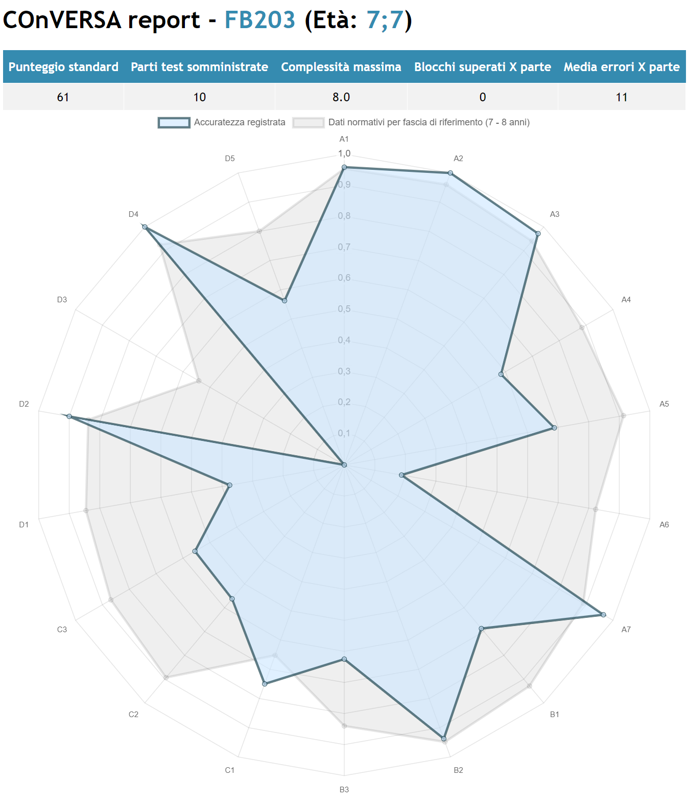
Comparing reports

Slide 44
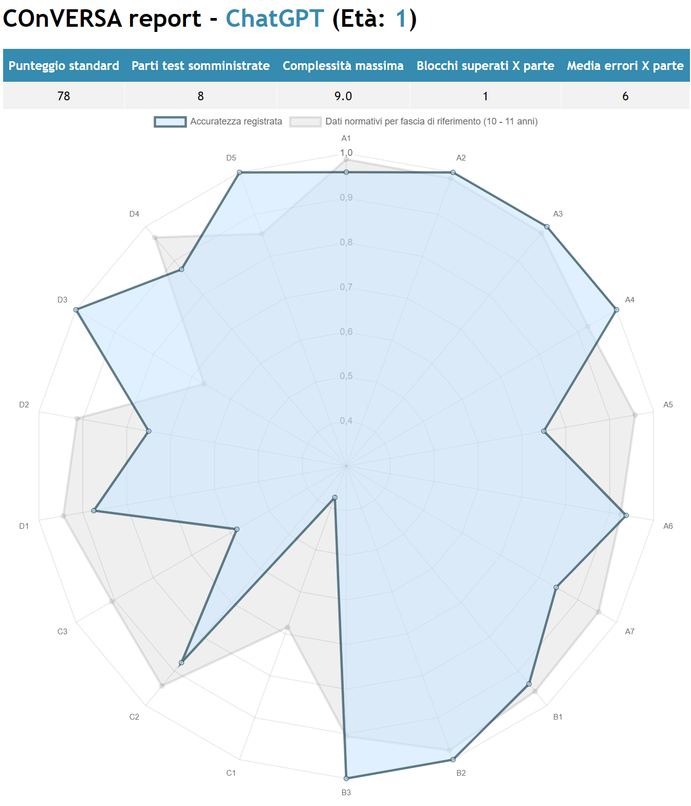
Report
ChatGPT
Control Values
Working Memory < 6 y.o. (L2 generally perform better, DC worse) Featural sensitivity < 6 y.o.
(both L2 and DC generally perform better) Lexicon = 6 y.o. (L2 generally perform better, DC worse)

Slide 45
Comparing reports

Slide 46
Conclusion
The COnVERSA test confirms a systematic difference in performance between Deaf and Hearing Children of the same age (cf. Chesi 2006 a.o.).
Age seems is a relevant factor for predicting the linguistic developmental pattern in HC, but, generally, not in DC
Hearing aid is a crucial factor: DC with cochlear implant significantly show a much better performance in all area (confirming Guasti et al. 2014, Friedmann & Szterman 2006, 2011 a.o.), but still, less discriminative ability than HC.
We conclude that COnVERSA and, more generally, the forced choice task based on minimal pairs, is a valid method for assessing linguistic competence also in the deaf population.

Slide 47
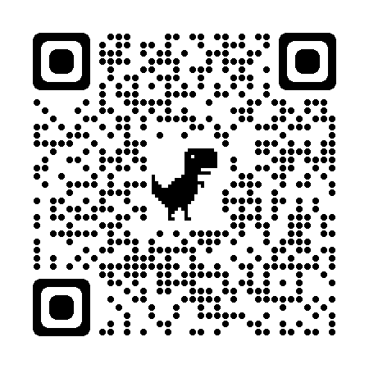
Selected references
COnVERSA online test: http://nets.iusspavia.it/tests/conversa/
Belletti, A., & Guasti, M. T. (2015). The Acquisition of Italian: Morphosyntax and its interfaces in different modes of acquisition. John Benjamins.
Chesi, C. (2006). Il linguaggio verbale non-standard dei bambini sordi. Roma: Ediz. Univ. Romane.
Chesi, C., & Canal, P. (2019). Person features and lexical restrictions in Italian clefts. Frontiers in Psychology, 10, 2105. Chesi, C., Ghersi, G., & Musola, D. (2019). L’acquisizione dei pronomi clitici nei sordi: evidenze a favore dell’utilità dell’esposizione a coppie minime. Studi e Saggi Linguistici, 57(1), 17-70.
Franck, J., Lassi, G., Frauenfelder, U. H., & Rizzi, L. (2006). Agreement and movement: A syntactic analysis of attraction. Cognition, 101(1), 173-216.
Friedmann, N., Belletti, A., & Rizzi, L. (2009). Relativized relatives: Types of intervention in the acquisition of A-bar dependencies. Lingua, 119(1), 67-88.
Friedmann, N., & Szterman, R. (2006). Syntactic movement in orally trained children with hearing impairment. Journal of Deaf Studies and Deaf Education, 11(1), 56-75.
Friedmann, N., & Szterman, R. (2011). The comprehension and production of Wh-questions in deaf and hard-of-hearing children. J. of Deaf St. & Deaf Ed., 16(2), 212-235.
Guasti, M. T. (1996). Acquisition of Italian interrogatives. Language Acquisition and Language Disorders, 14, 241-270.
Guasti, M. T., Papagno, C., Vernice, M., Cecchetto, C., Giuliani, A., & Burdo, S. (2014). The effect of language structure on linguistic strengths and weaknesses in children with cochlear implants: Evidence from Italian. Applied Psych., 35(4), 739-764.
Hyams, N., & Schaeffer, J. (2007). Clitic and auxiliary omissions in Italian children’s participle constructions. In Language acquisition and development. Proceedings of GALA (pp. 292-302).
Moscati, V., & Rizzi, L. (2014). Agreement configurations in language development: a movement-based complexity metric. Lingua, 140, 67-82.
Notes:
Evolution: A theory able to predict language changes is favored.
Computational Efficiency:

